Slide 1
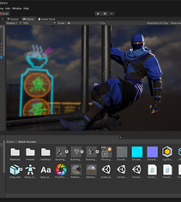
Introduction to Unity3D
Presented by: Vinh T. Nguyen, PhD
Monday, Oct 19, 2020, Texas Tech University

Slide 2
Who am I?

Slide 3
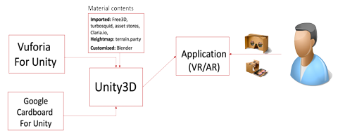
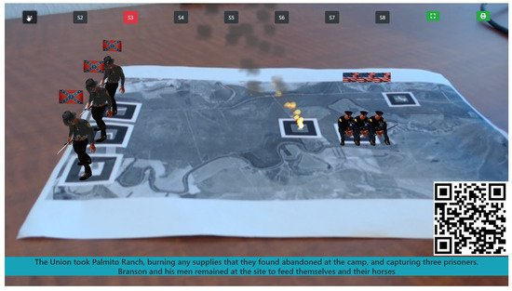
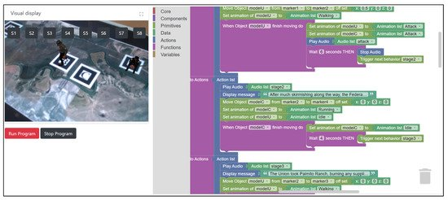
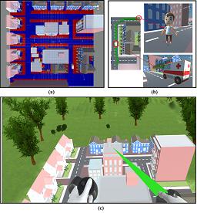
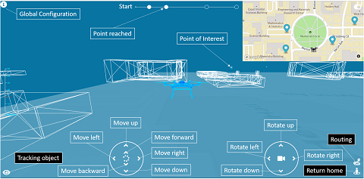
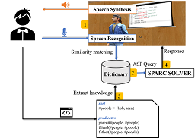
Projects on VR/AR

Slide 4
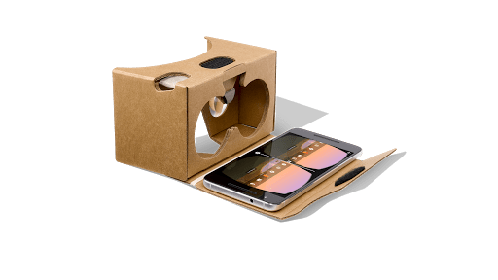
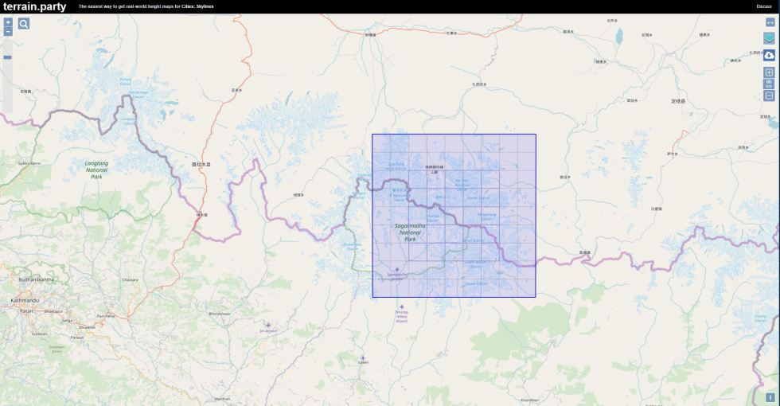
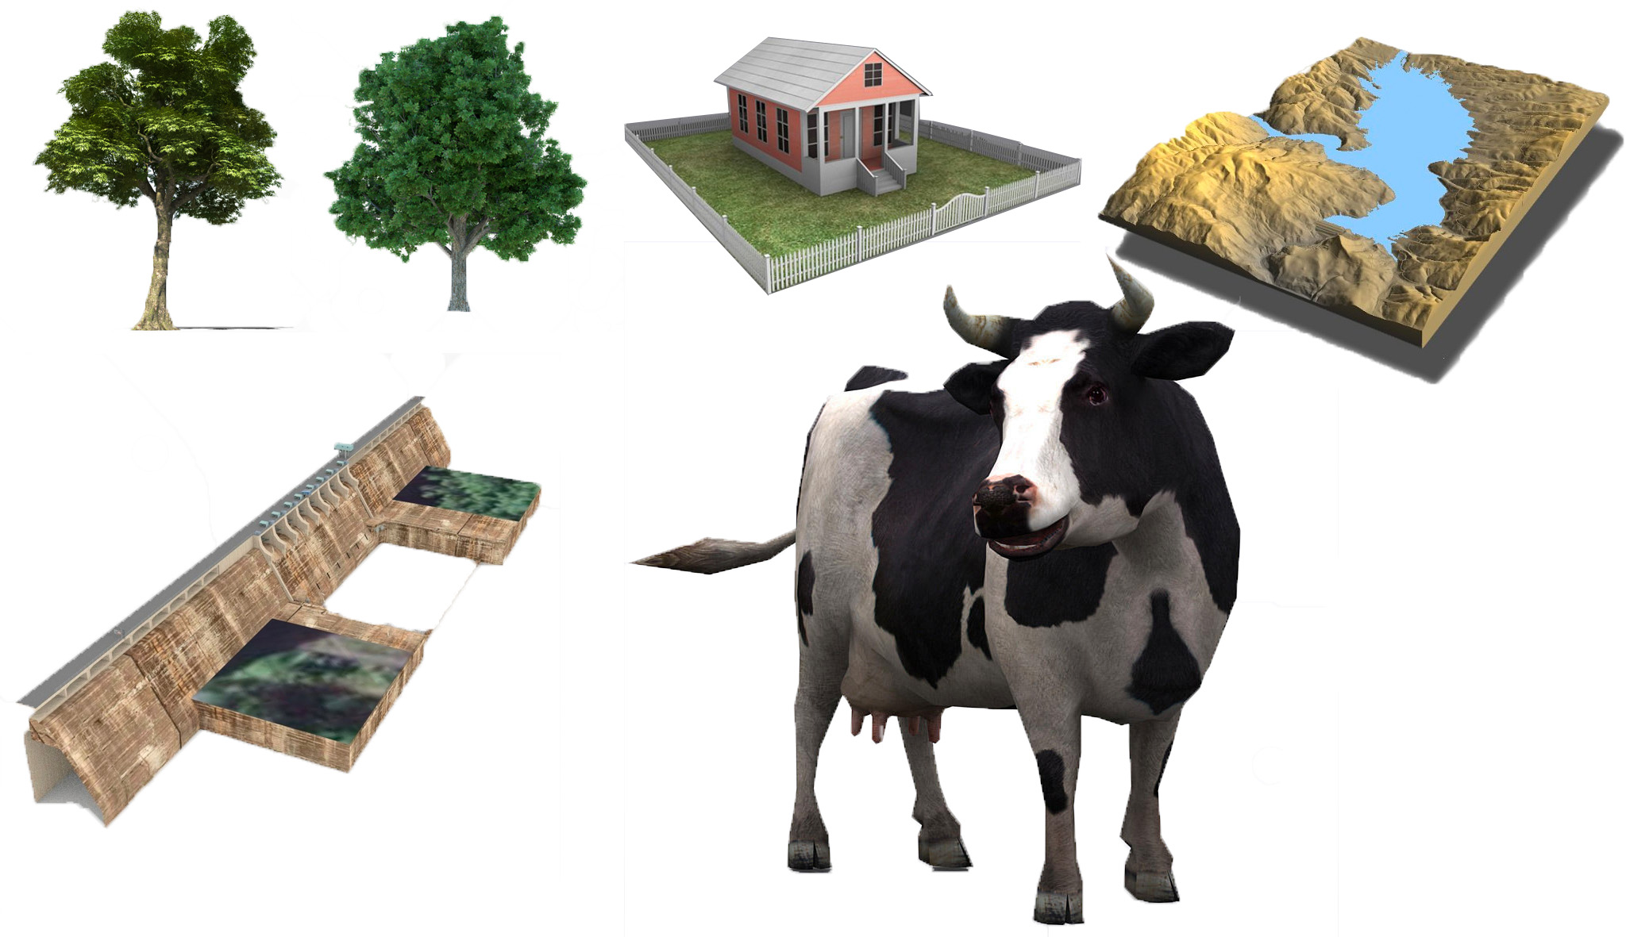
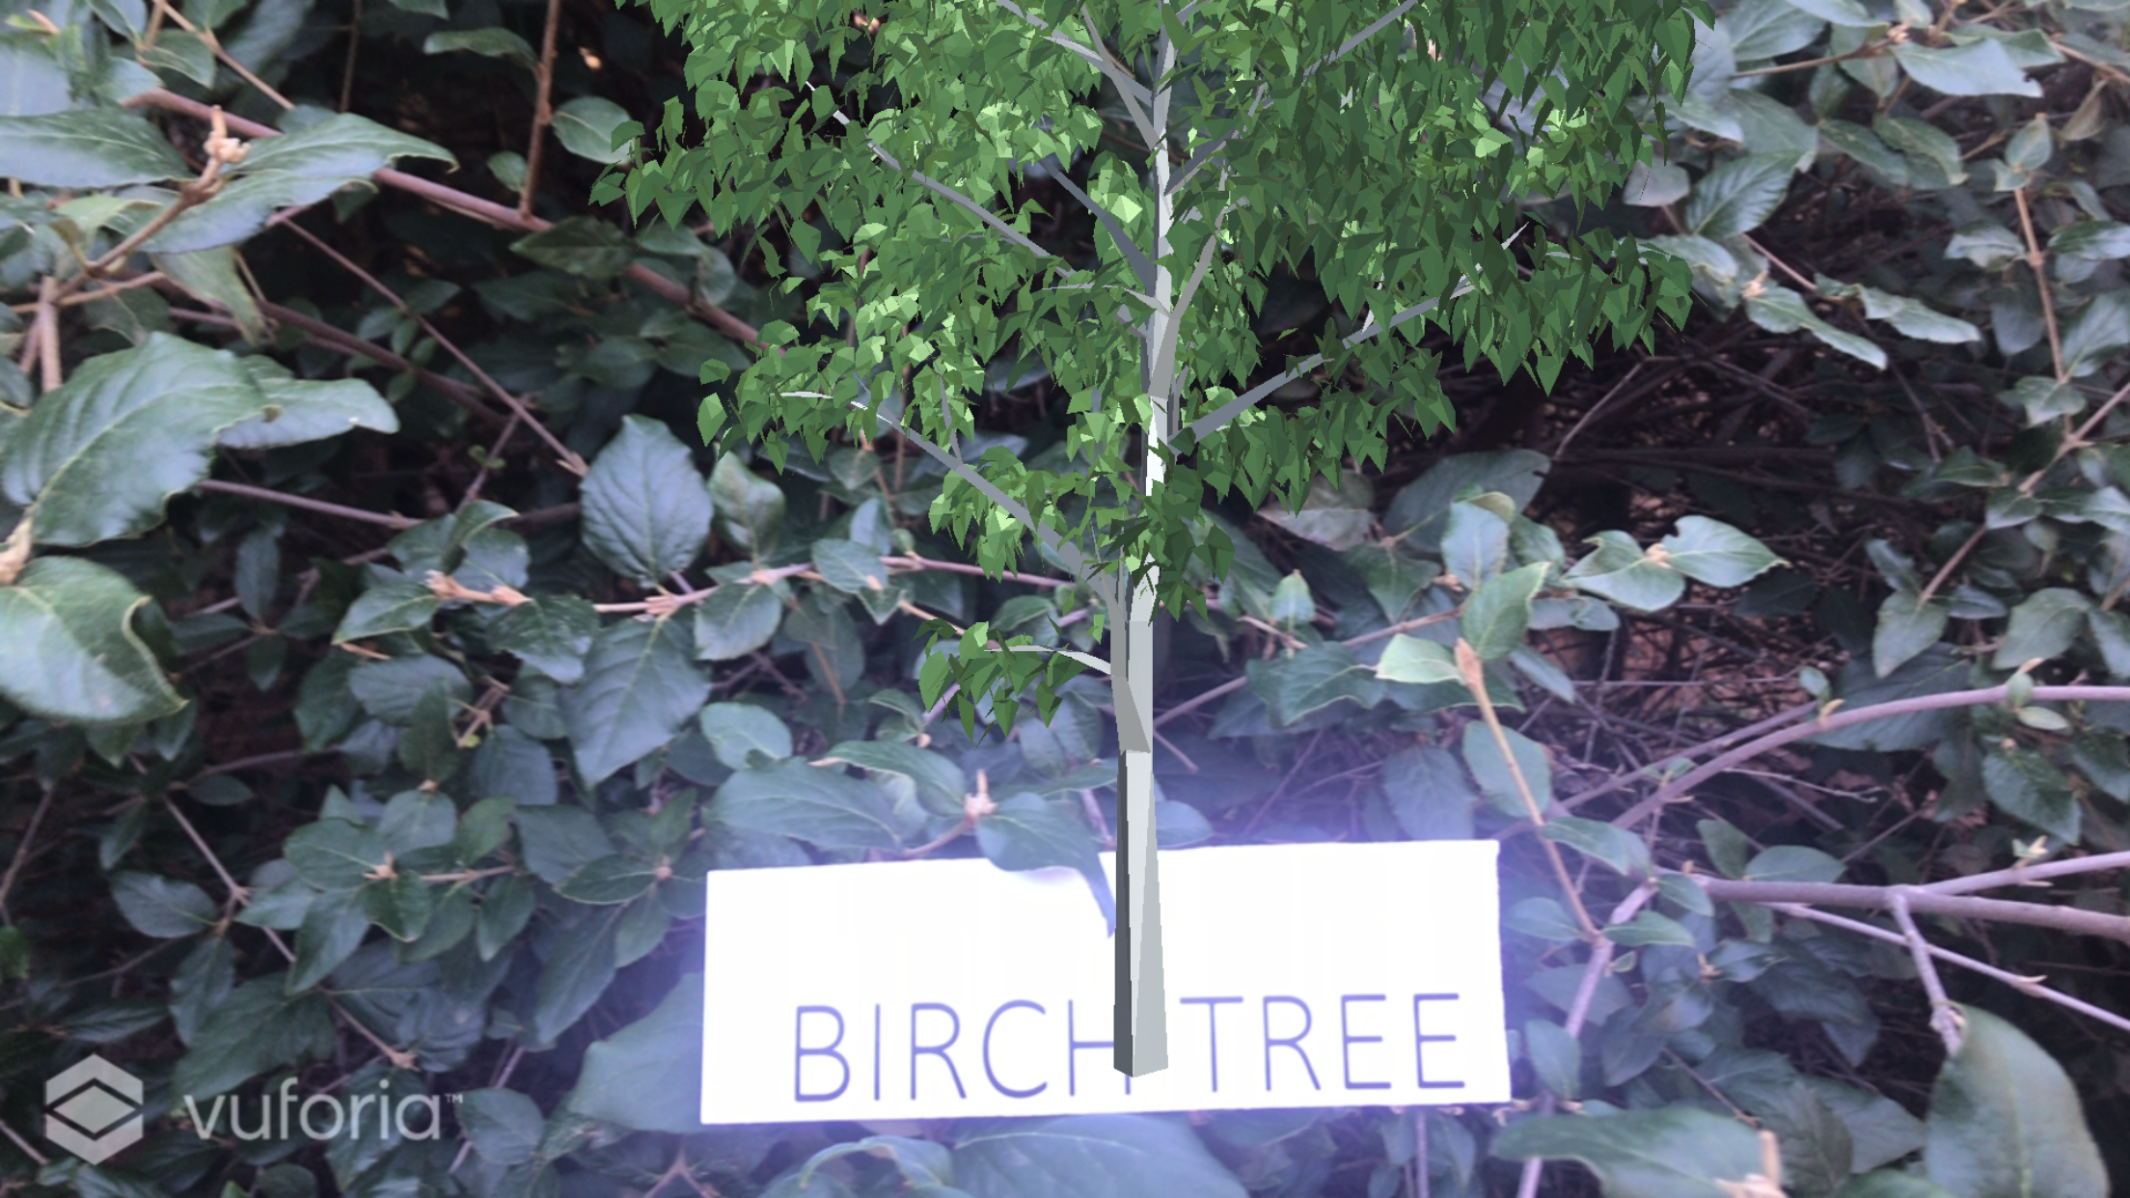
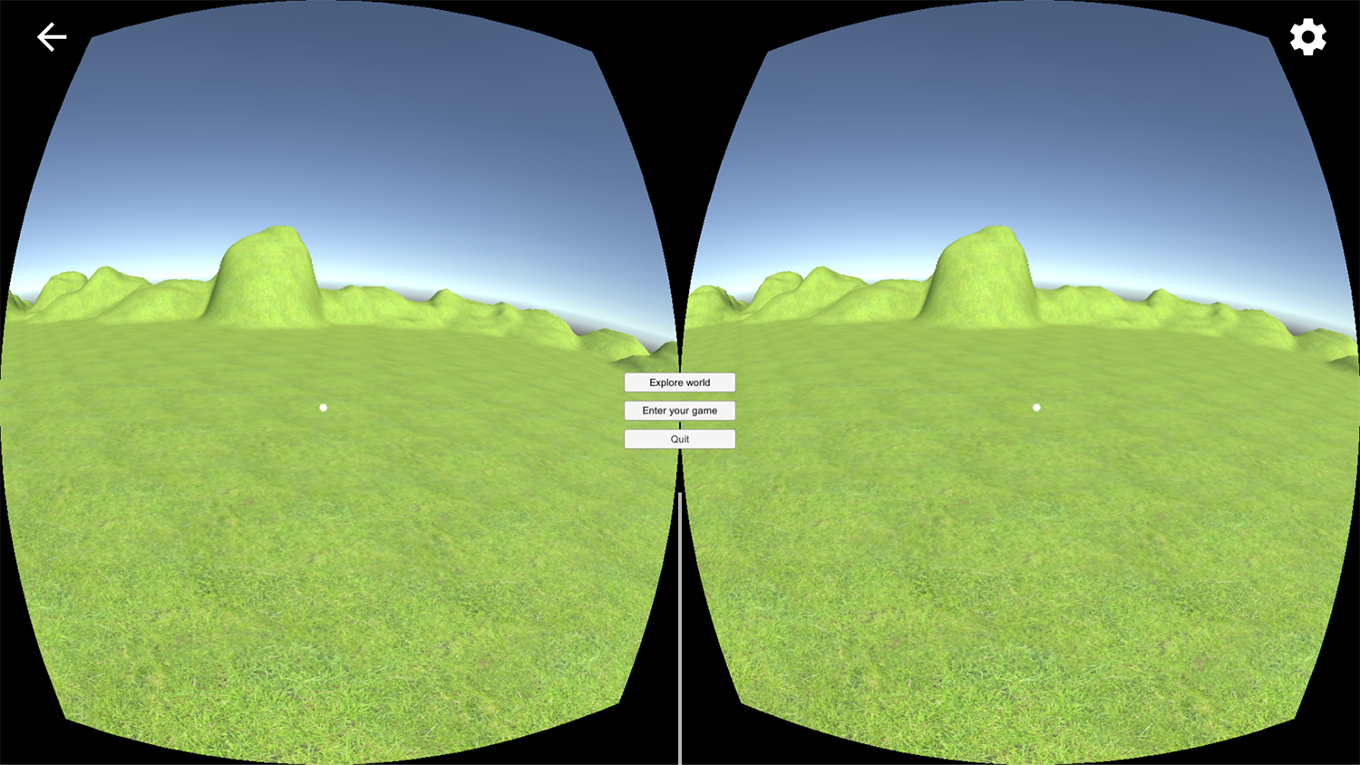
Setting up virtual reality and augmented reality learning environment in Unity
Technologies used:
Terrain.party

Slide 5
Projects on VR/AR

Slide 6
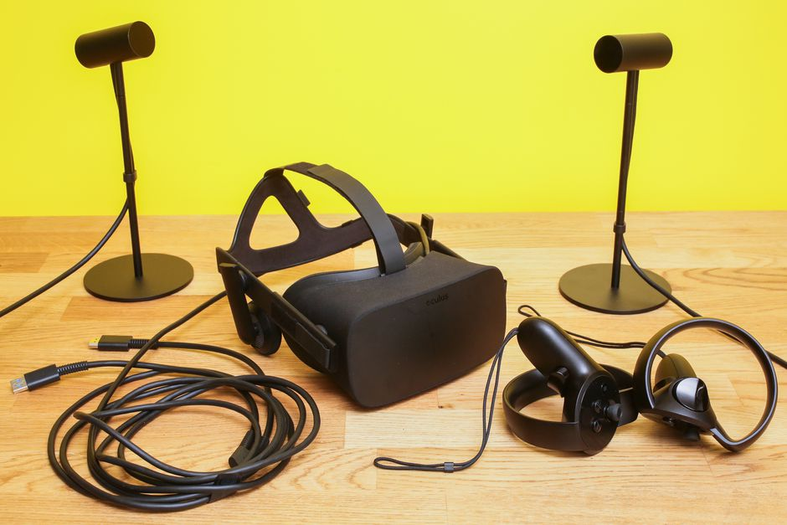
VRescuer: A Virtual Reality Application for Disaster Response Training
Demo: https://youtu.be/UdZD39-wGvQ
Technologies used:

Slide 7
Projects on VR/AR

Slide 8
DroneVR: A Web Virtual Reality Simulator for Drone Operator
Technologies used:
MapboxGL
ThreeJS
https://youtu.be/ZOkB-_ck4lE

Slide 9
Projects on VR/AR

Slide 10
Projects on VR/AR
Technologies used:
A-Frame
AR.js
Speech synthesis
Mixamo.com
Blockly

Slide 11
Two ecosystems of AR/VR
Web-based VR/AR
In-app VR/AR
Accessible to everyone
Bring user experiences

Slide 12
What happen if
We want to make a more interesting project?
Take advantage of many existing work?
Have more experiences in AR/VR?
Lessen time taken for a complicated project?

Slide 13
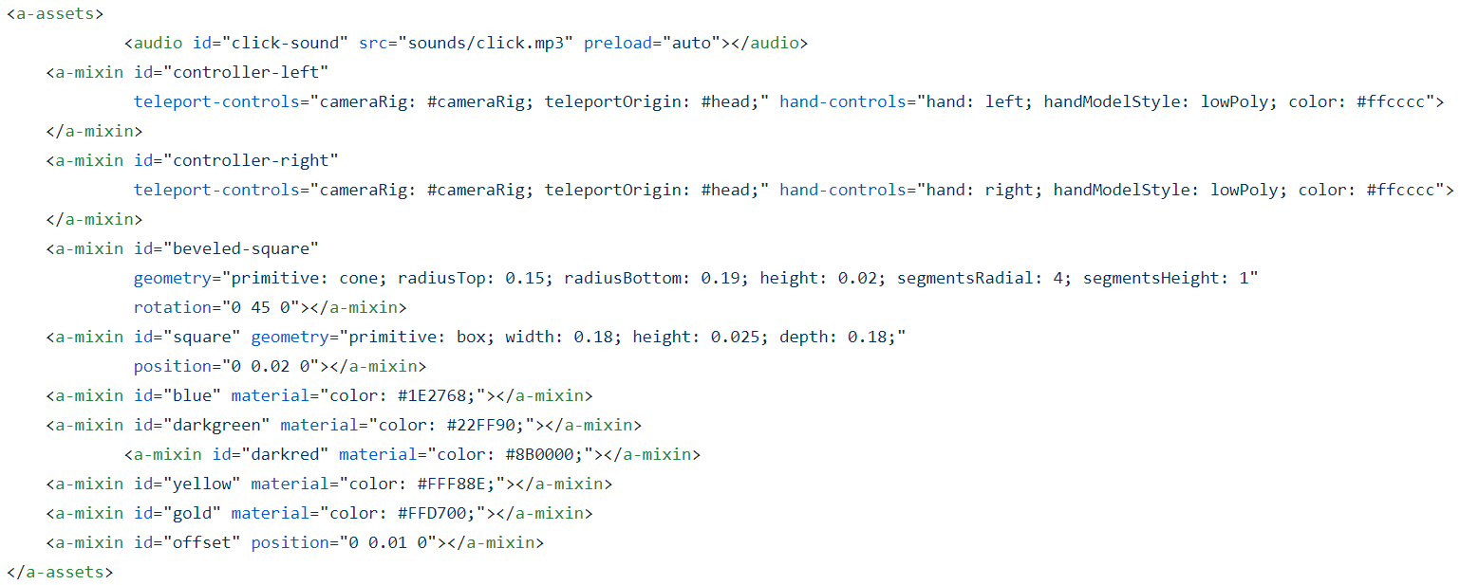
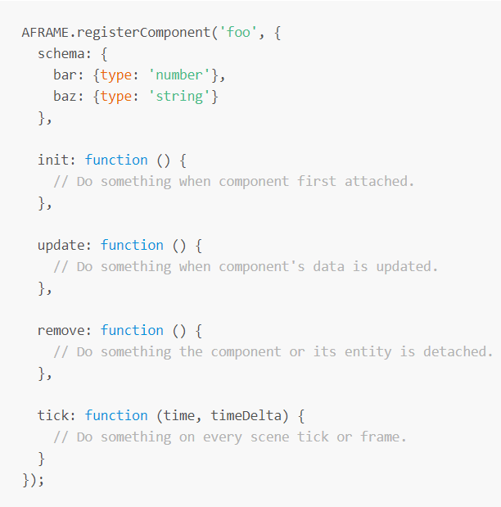
Recap from Project 1 (web-based)
Too much effort to manage every single piece of codes
and error prone

Slide 14
Introduction to Unity3D
I would like you to think of it as a tool/software to accelerate making VR/AR apps with plenty of available components
The basic idea of creating VR/AR is the same with web-based VR/AR
It helps you to manage and organize the codes and assets in a structural way.

Slide 15
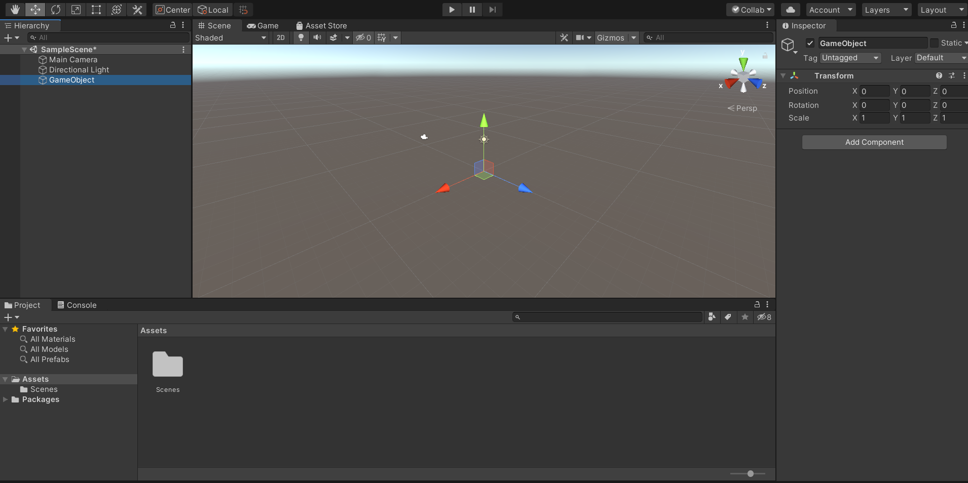
Unity3D layout
A
B
C
D

Slide 16
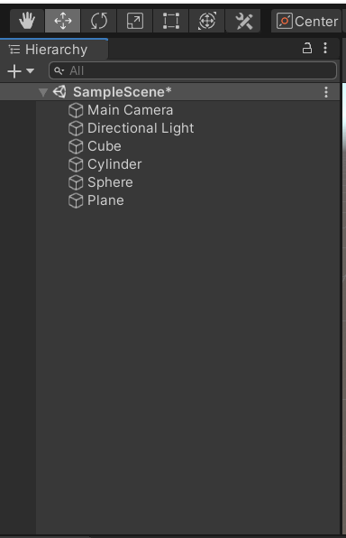
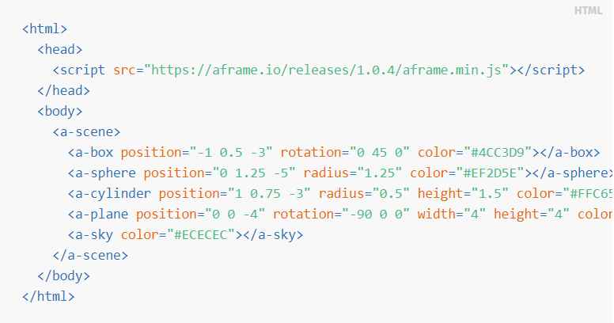
Get started with Unity3D
A

Slide 17
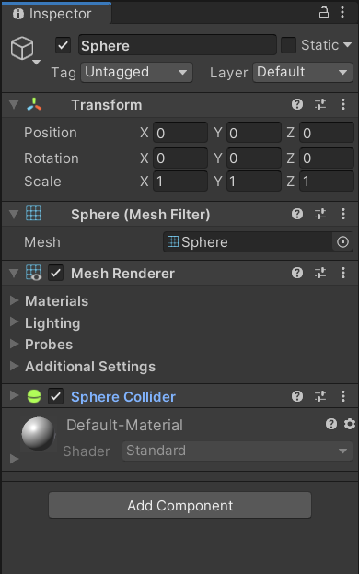
Get started with Unity3D
C

Slide 18
Get started with Unity3D
C

Slide 19
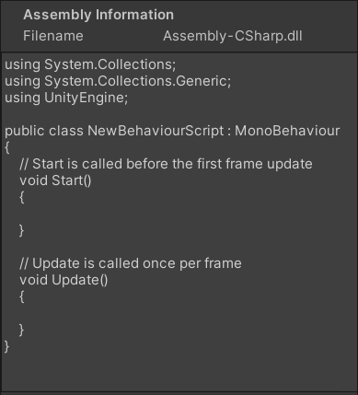
Get started with Unity3D

Slide 20
Unity3D layout
A
B
C
D

Slide 21
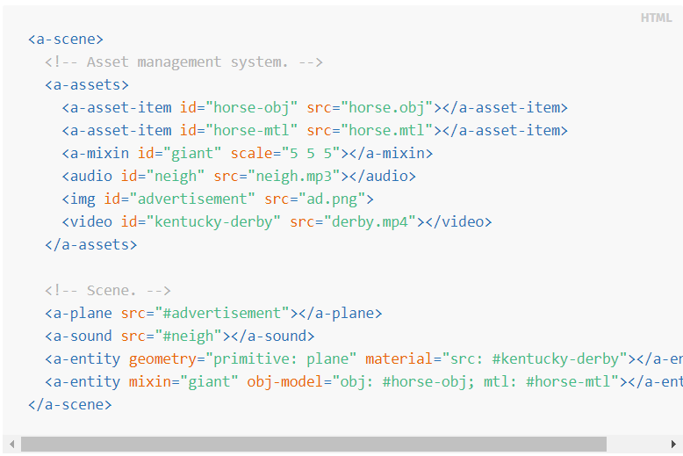
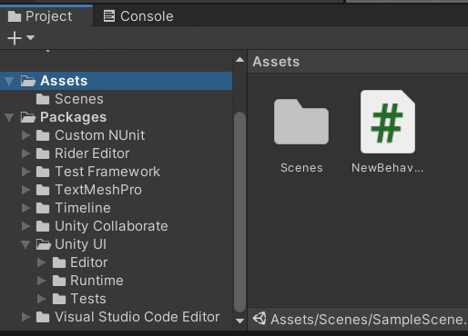
Get started with Unity3D
D

Slide 22
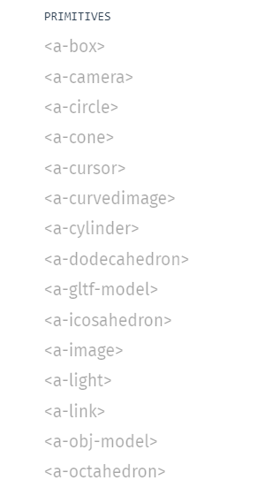
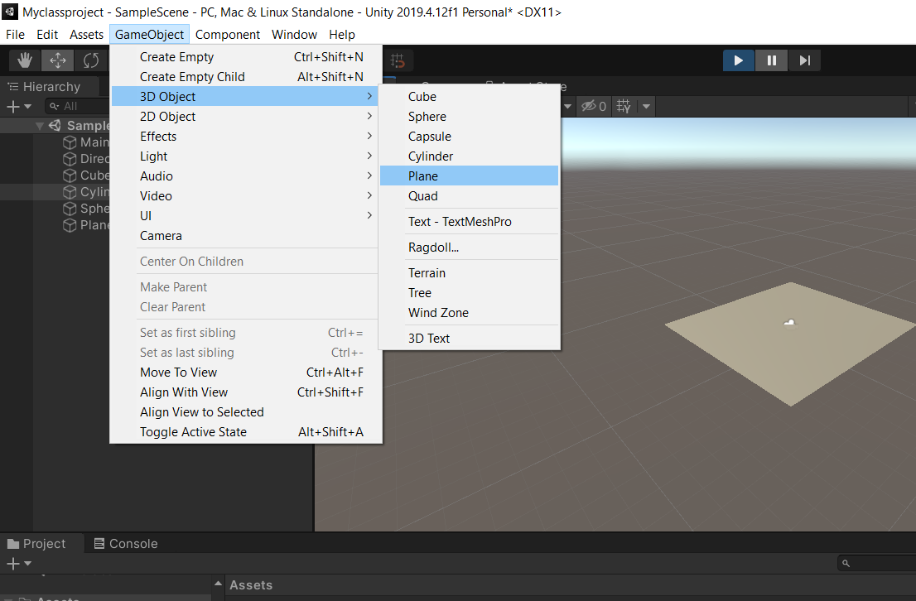
Available primitive components

Slide 23
Collaboration
GitHub
- Individual file size <=50Mb
- Need some configurations
- Many users
- Project size < 1Gb
- Unity will handle everything
- Team members <= 3

Slide 24
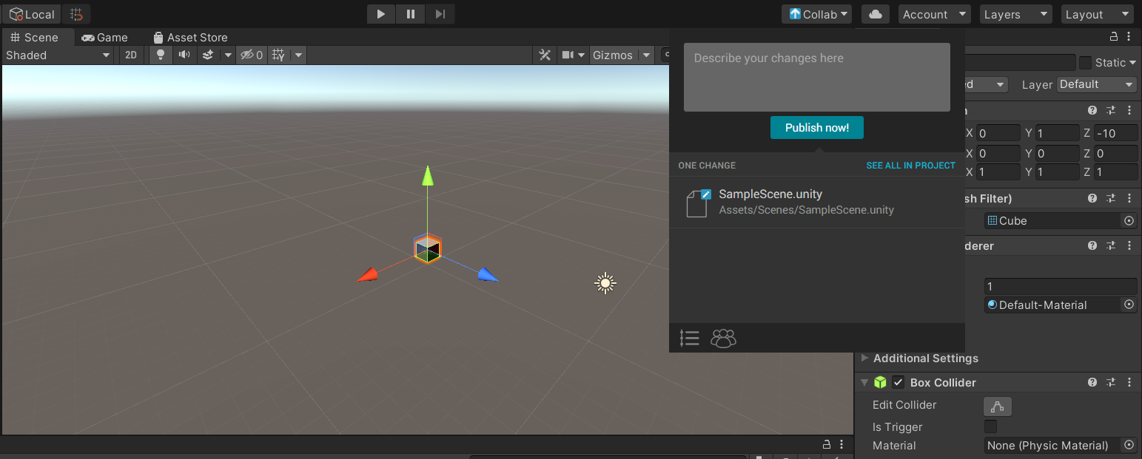
Collaboration with Unity

Slide 25
Collaboration with Unity

Slide 26
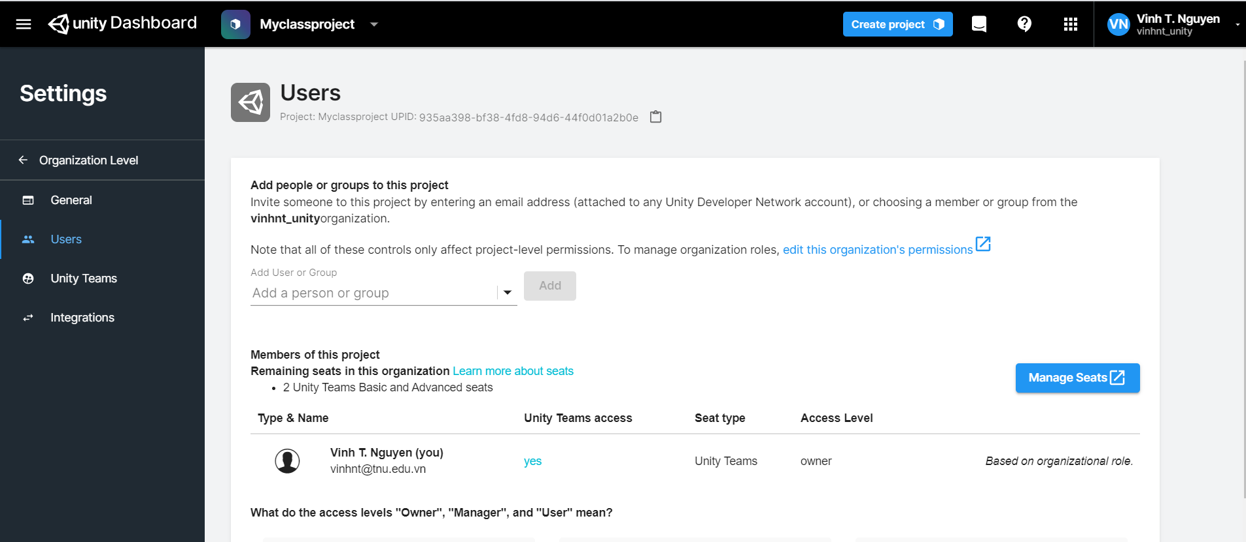
Collaboration with Unity

Slide 27
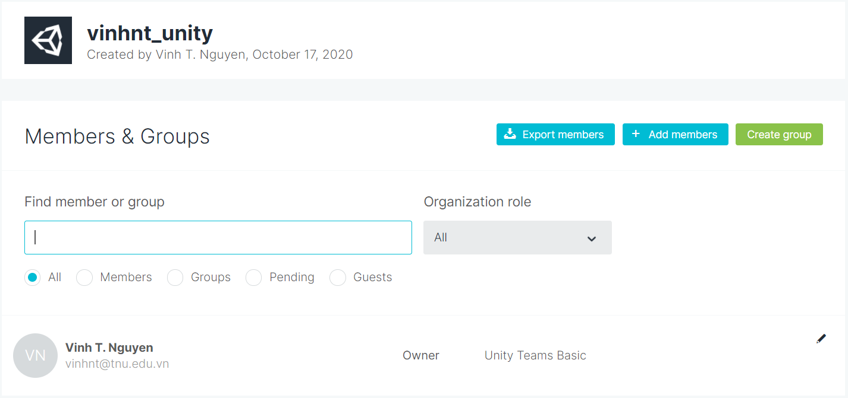
Collaboration with Unity

Slide 28
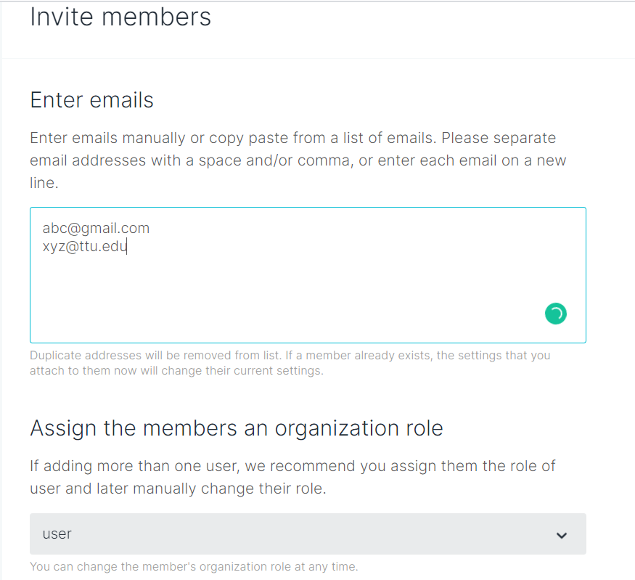
Collaboration with Unity

Slide 29
Collaboration with Unity

Slide 30
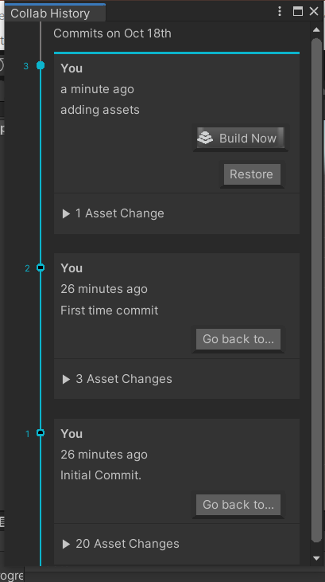
Collaboration with Unity

Slide 31
Collaboration
GitHub
- Individual file size <=50Mb
- Need some configurations
- Many users
- Project size < 1Gb
- Unity will handle everything
- Team members <= 3

Slide 32
Collaboration with GitHub

Slide 33
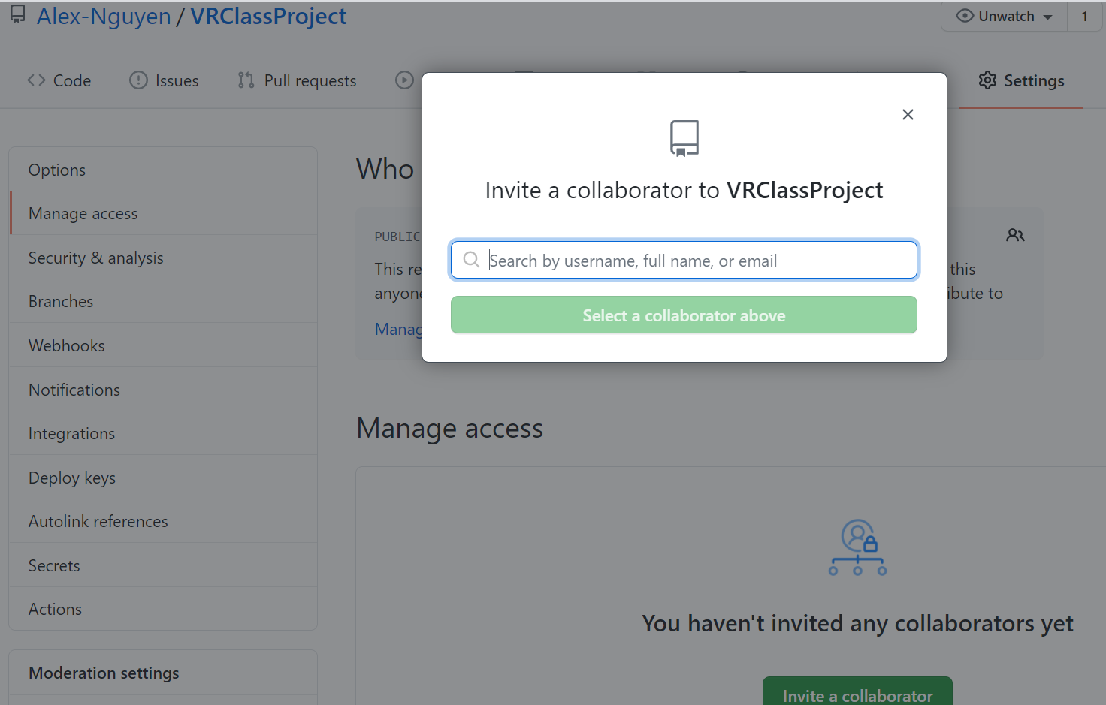
1
2
3

Slide 34
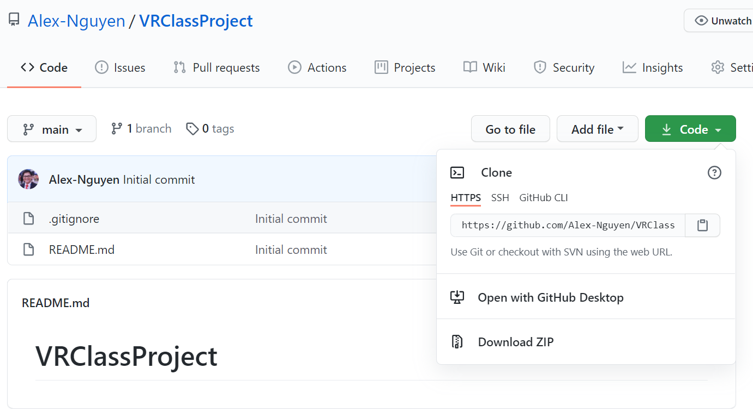
Collaboration with GitHub

Slide 35
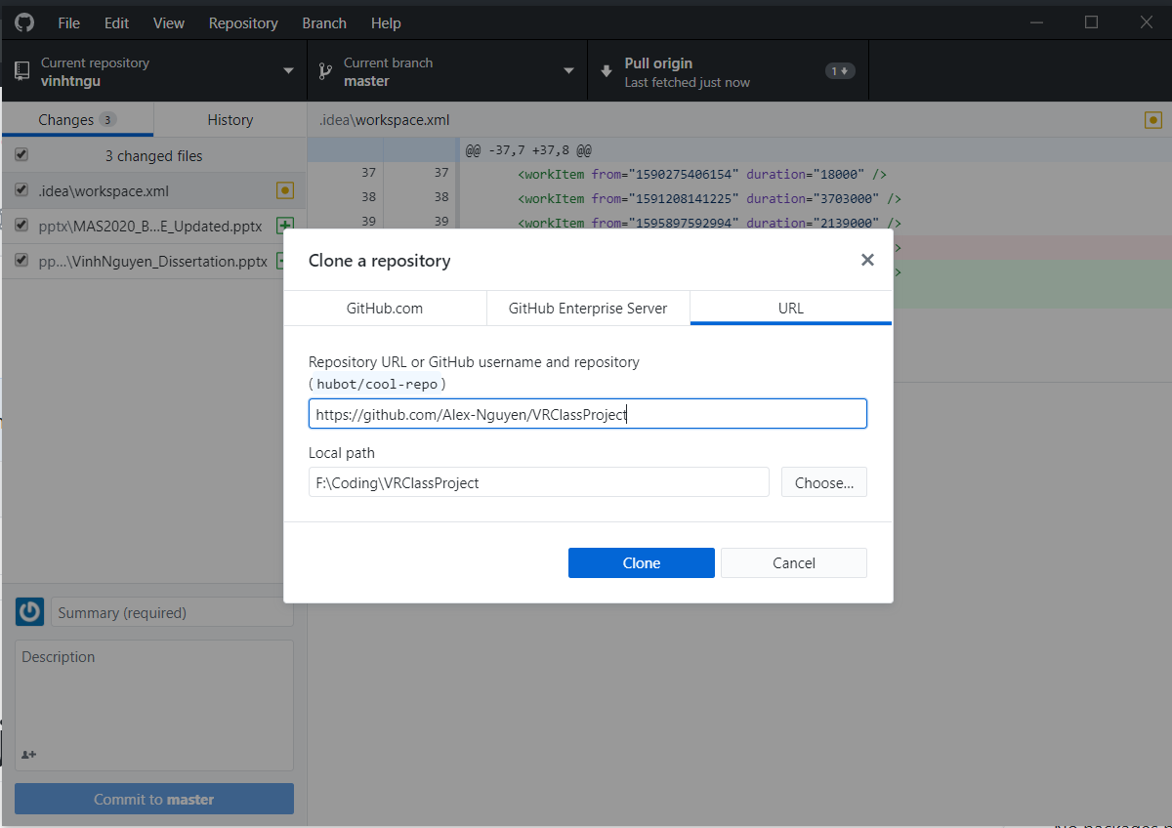
Collaboration with GitHub

Slide 36
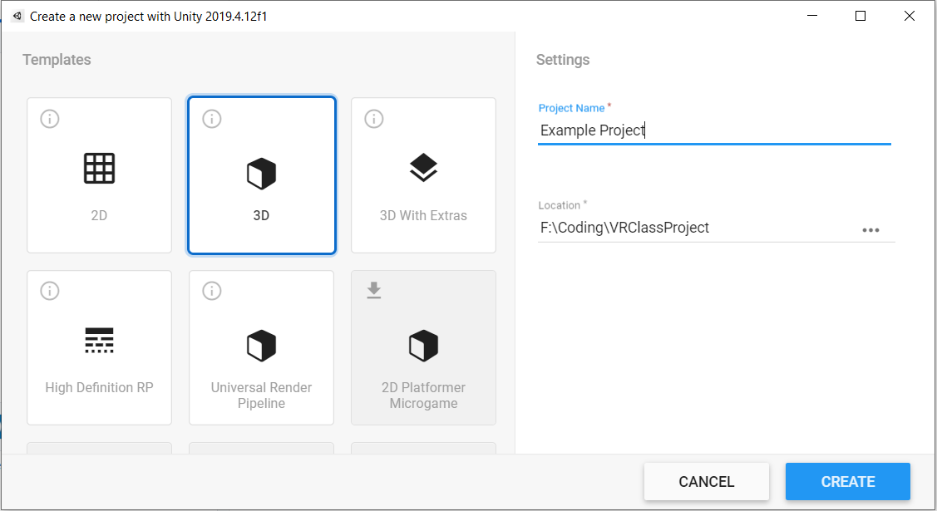
Choose location the same local path with GitHub

Slide 37
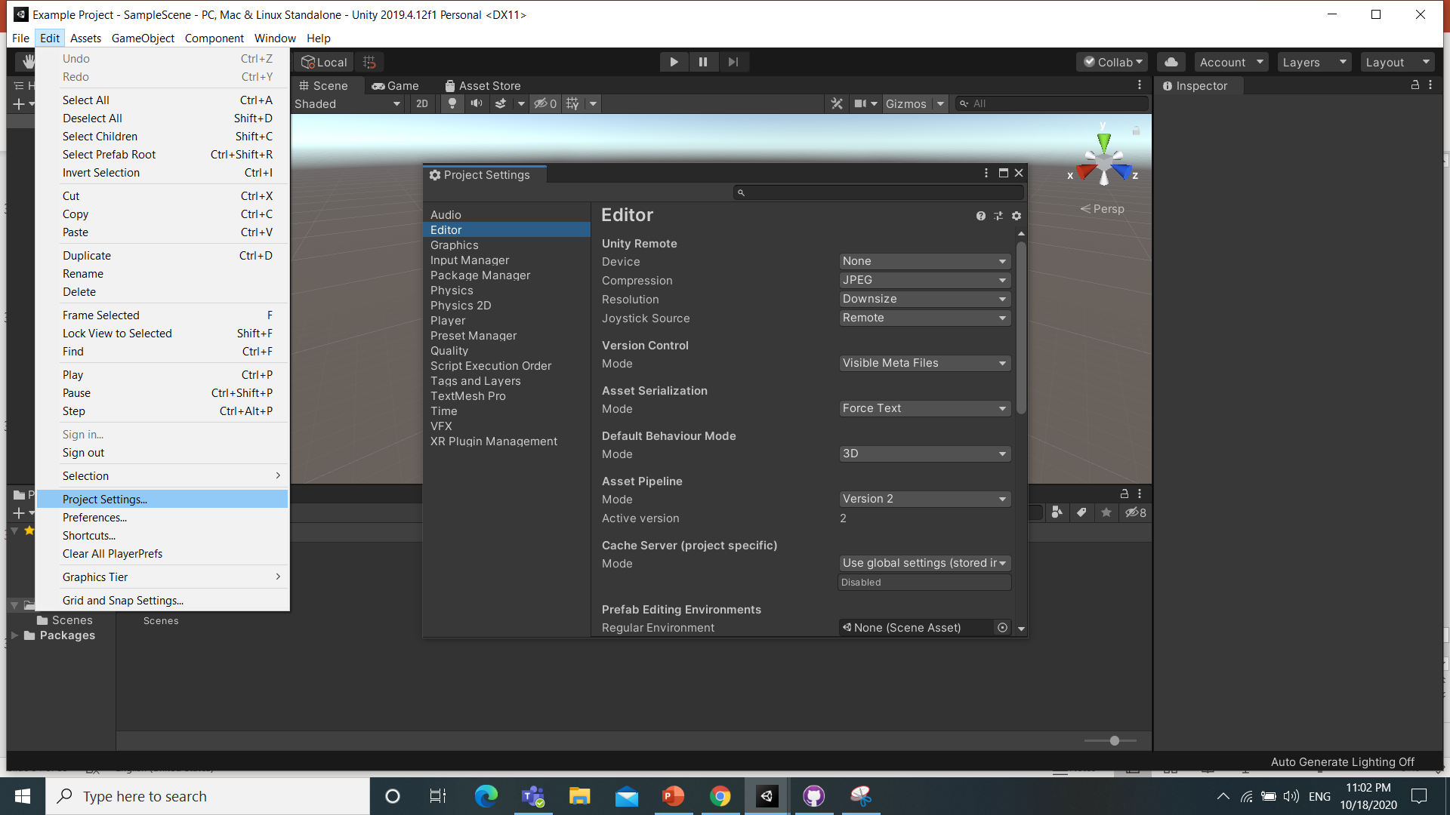
Make sure your configs are the same

Slide 38
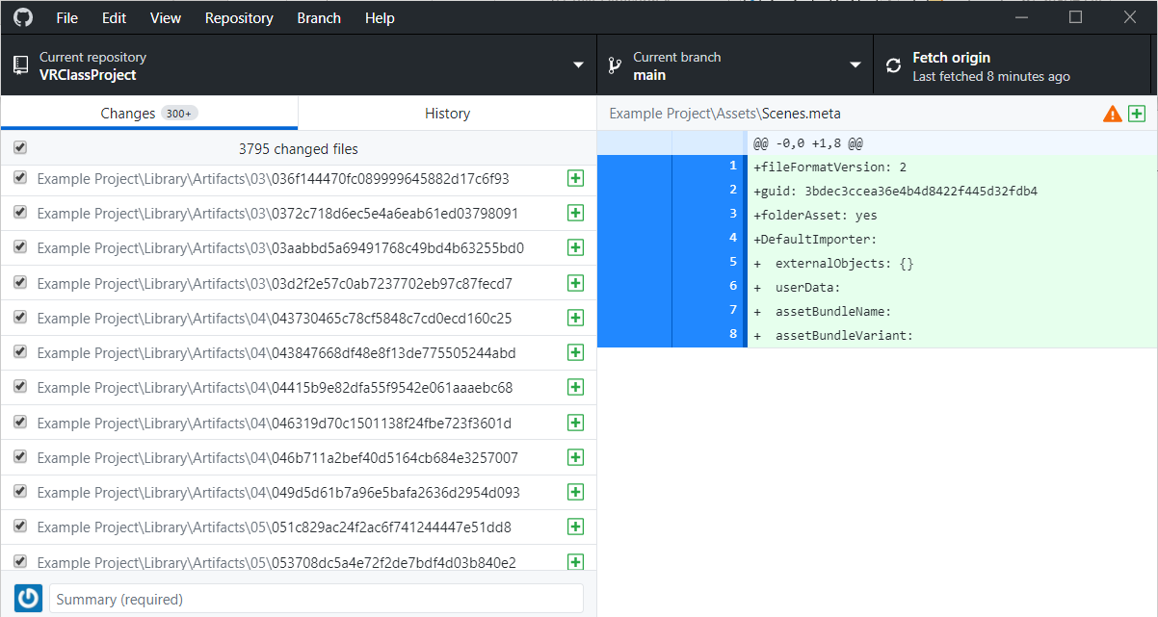
Lot of temporary files are included

Slide 39
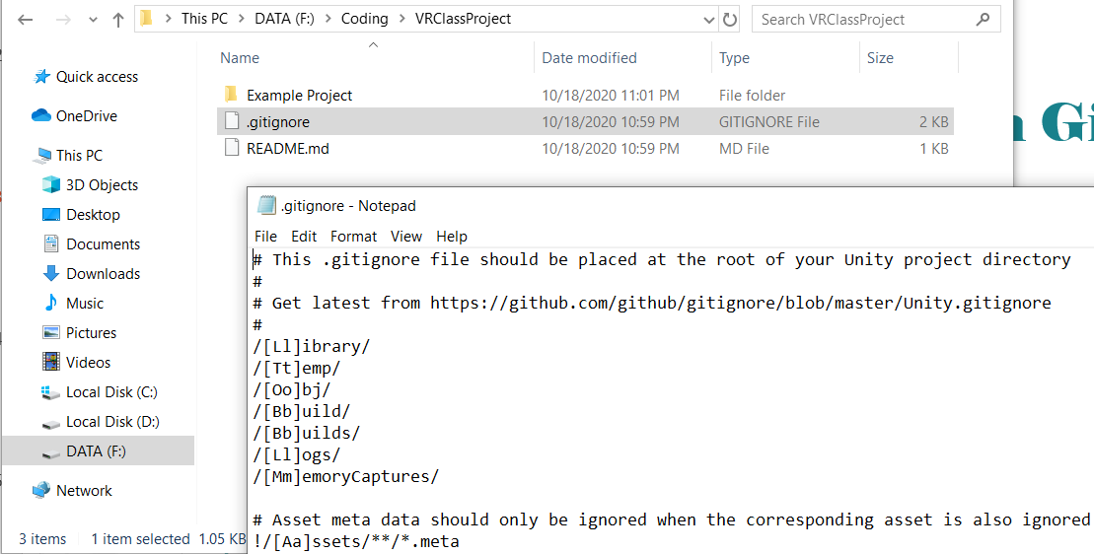
Modify the .gitignore relative path

Slide 40
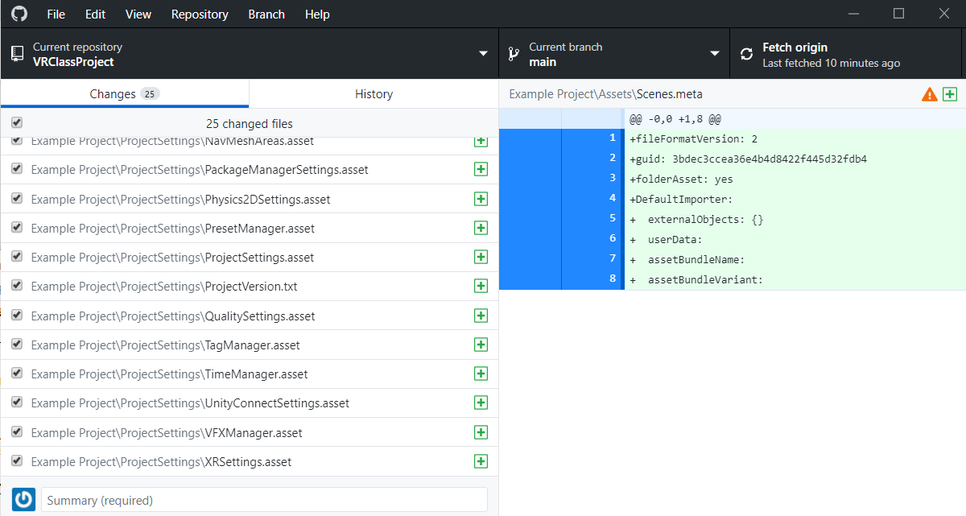
Removed temp files (3.7k -> 25 files)

Slide 41
Questions?

