Slide 1
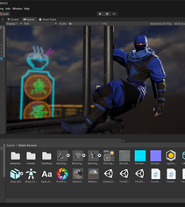
Introduction to Unity3D
Presented by: Vinh T. Nguyen, PhD
Monday, Oct 19, 2020, Texas Tech University

Slide 2
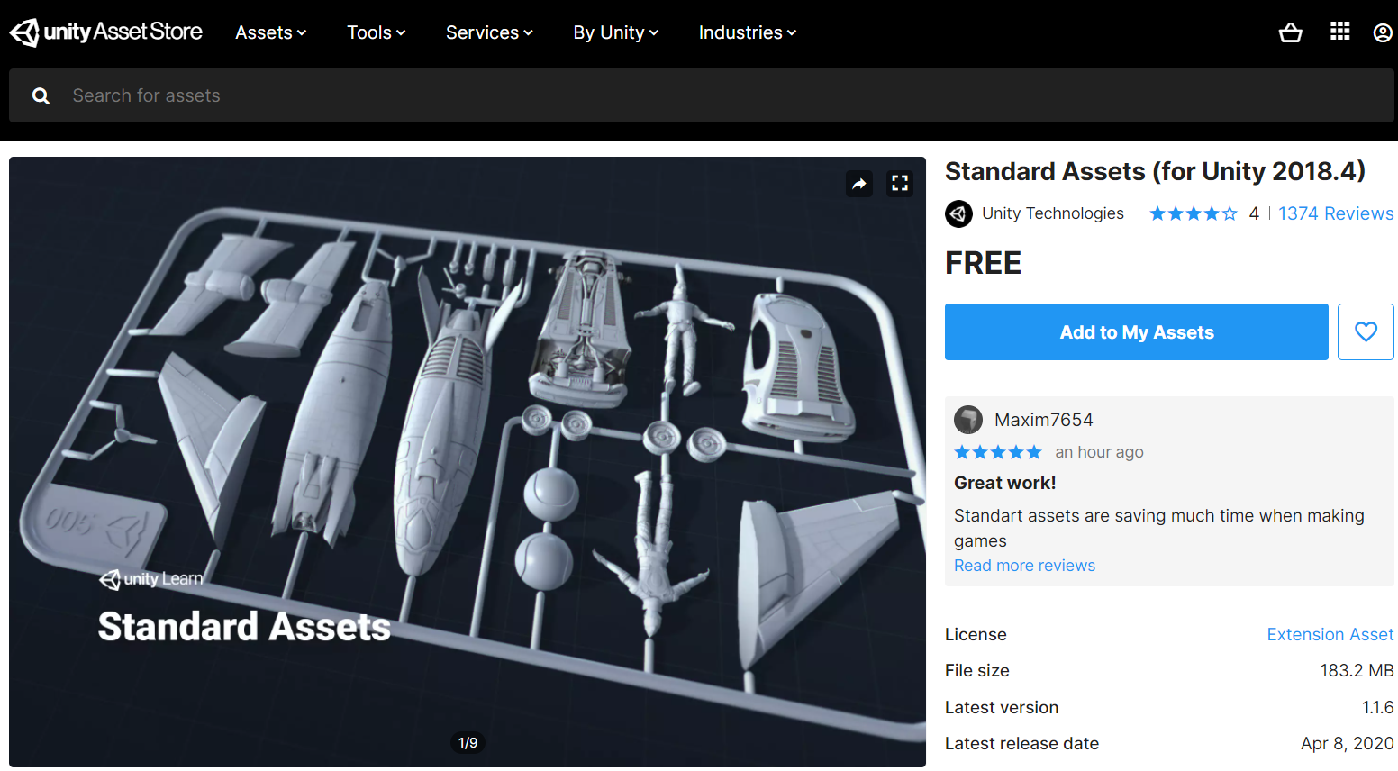
Where to start?
Check Unity version

Slide 3
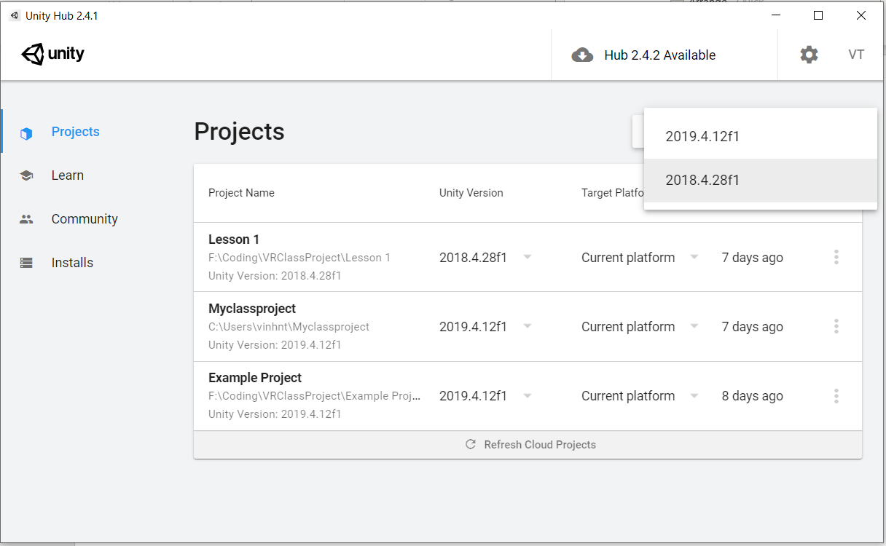
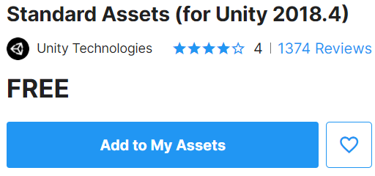
Check Unity asset version

Slide 4
Check Unity asset version
After imported assets, you will find it under Assets folder, including source code, prefab, sample scenes…

Slide 5
Customize your project
Create an object with materials, for example ceiling/floor
Step 1: Import your assets (e.g., image, 3d models…)

Slide 6
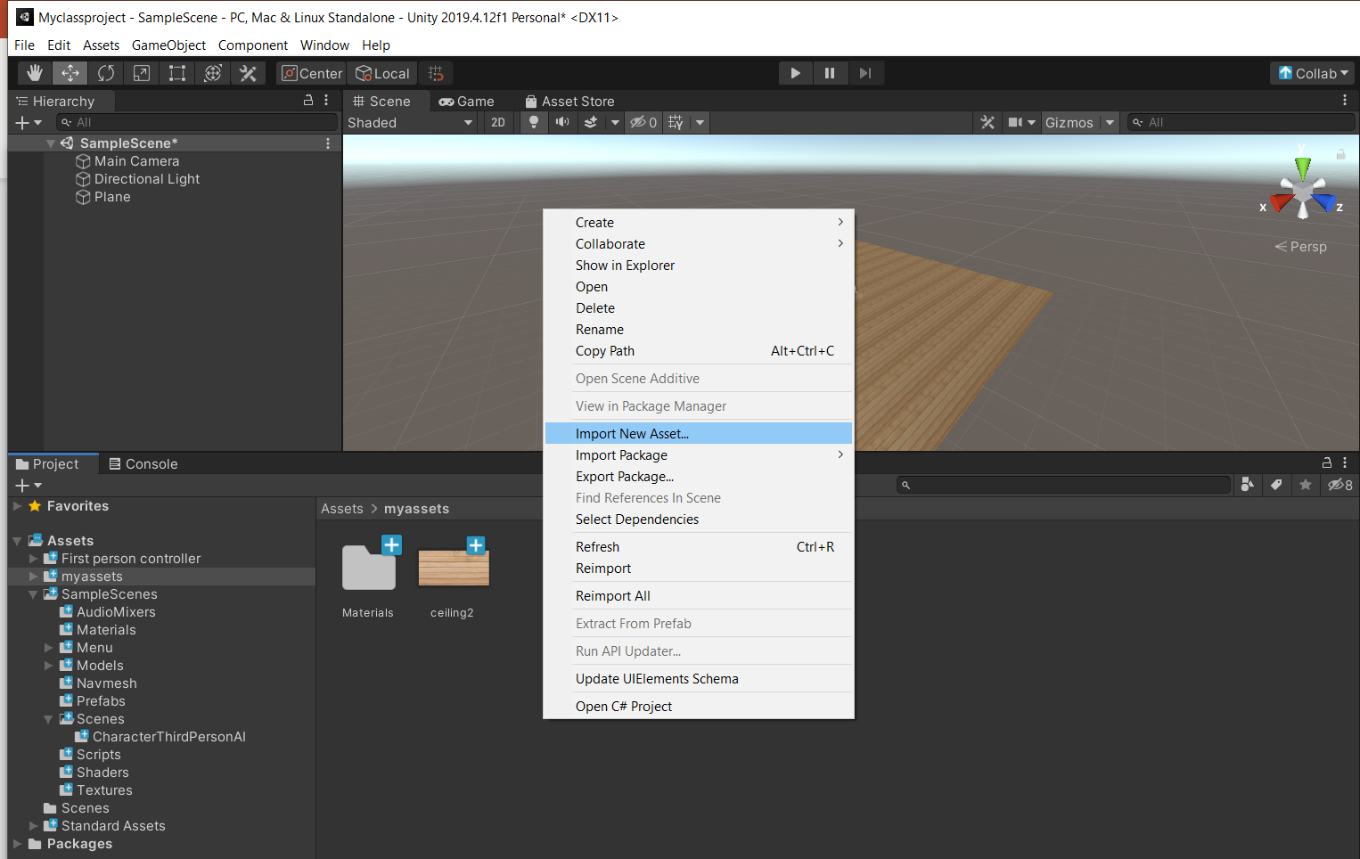
Customize your project
Create an object with materials, for example ceiling/floor
Step 2: Right click for Import New Asset… or you can drag/drop your images/models directly into your assets folder

Slide 7
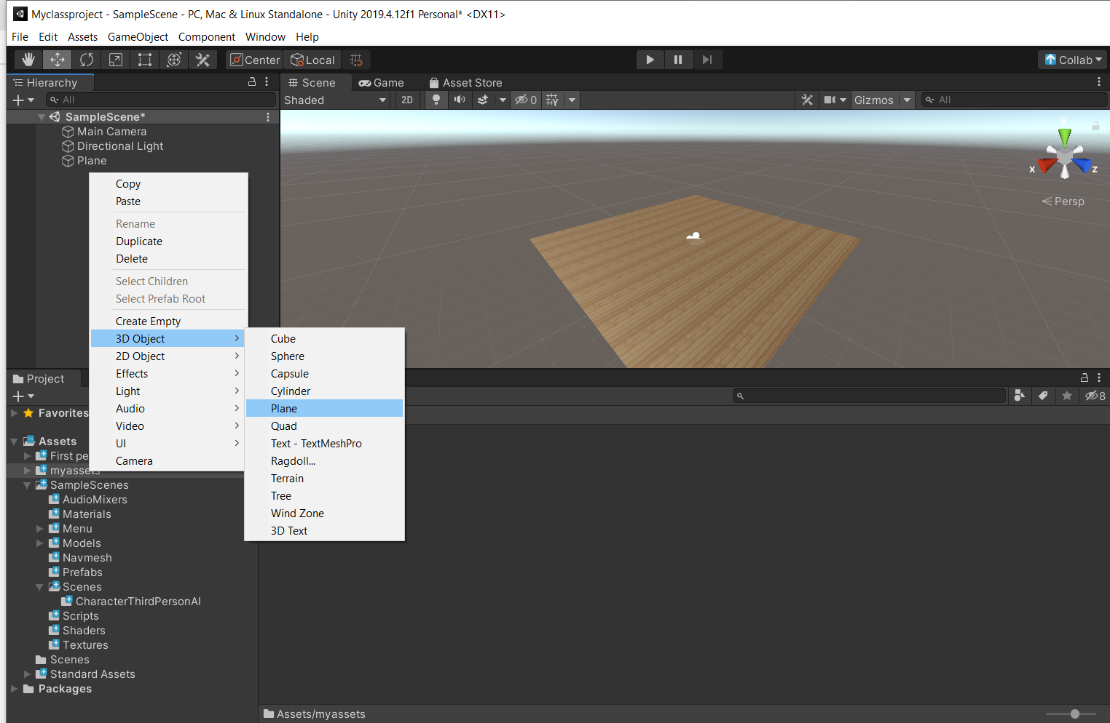
Customize your project
Create an object with materials, for example ceiling/floor
Step 3: Create your new primitive object (or entity in A-Frame). For example, a plane (for flat surfaces such as walls/floor/ceiling)

Slide 8
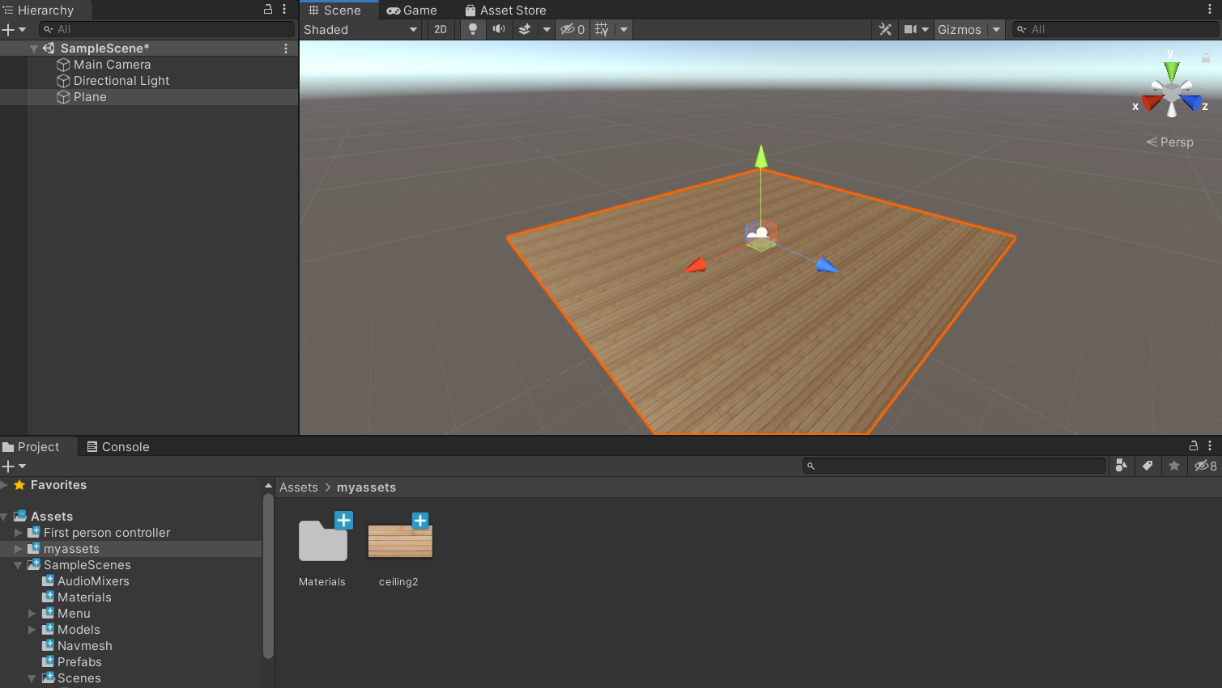
Customize your project
Step 4: Drag your material directly to the object either in the Hierarchy or Scene view

Slide 9
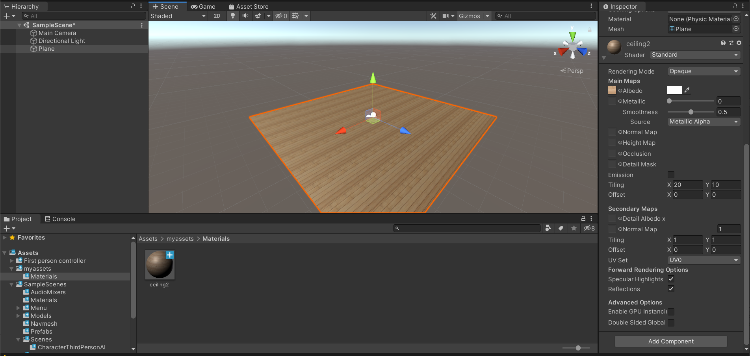
Customize your project
Step 5: Change the size of the materials (or repeat property in A-frame).

Slide 10
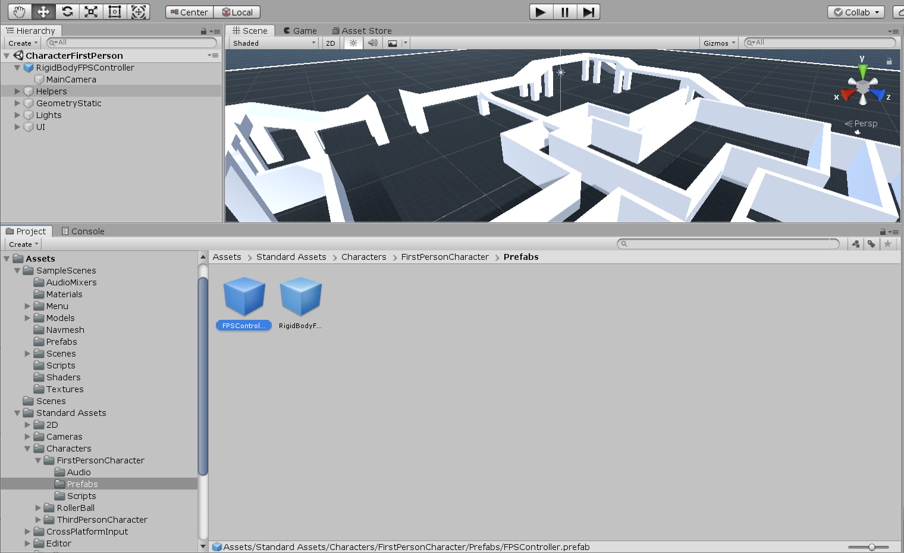
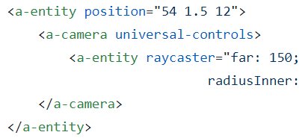
Adding navigation to the scene
You can add First Person Controller, or Third Person Controller. All the codes are already there to use.
This is equivalent to a-camera in A-Frame
3
2
1

Slide 11
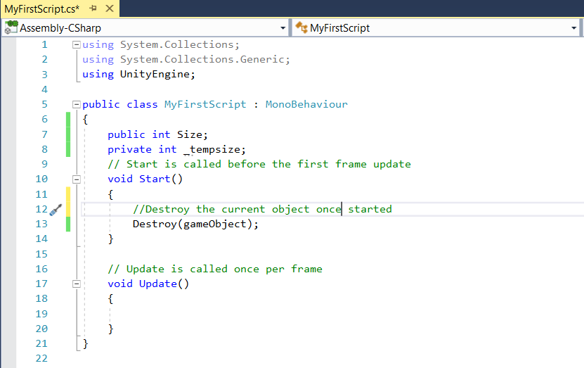
Writing scripts some notes
Note:
- By default, every script is derived from Monobehaviour, use it for event handler unless your class is only used for storing information.
- We have private/public variables like any other programming language mechanism.
- In JavaScript, we use this to refer to its object, in Unity we use gameObject

Slide 12
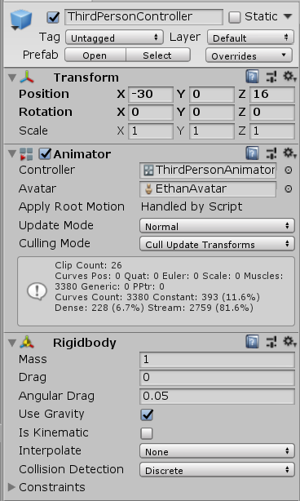
Writing scripts some popular functions
For default components
transform.position = new Vector3(0, 0,0)
transform.rotation = Quaternion.Euler()
For attached components
gameObject.GetComponent<Rigidbody>();

Slide 13
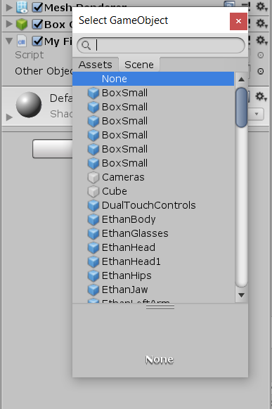
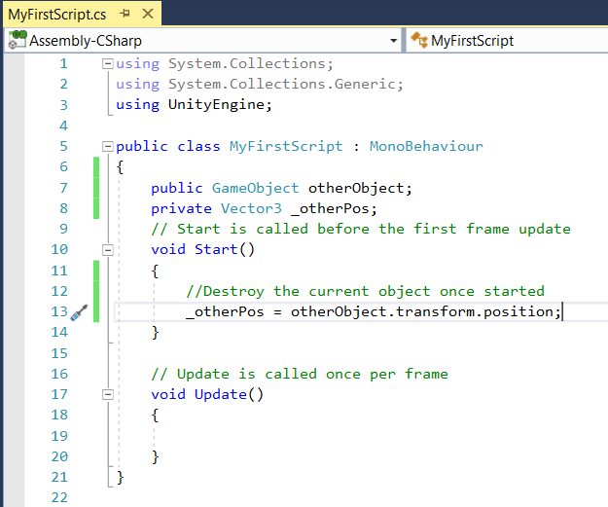
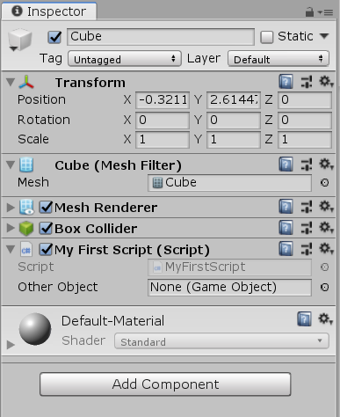
Writing scripts some popular functions

Slide 14
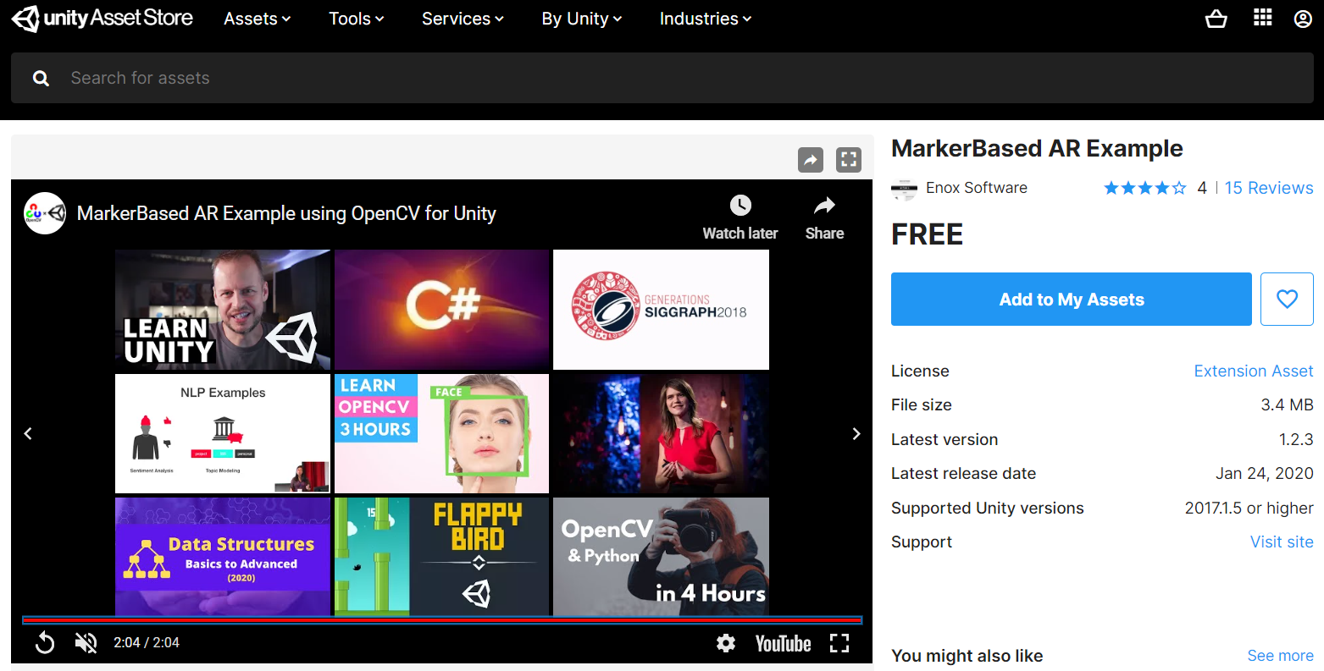
Want to make AR apps? Search template from Assets Store

Slide 15
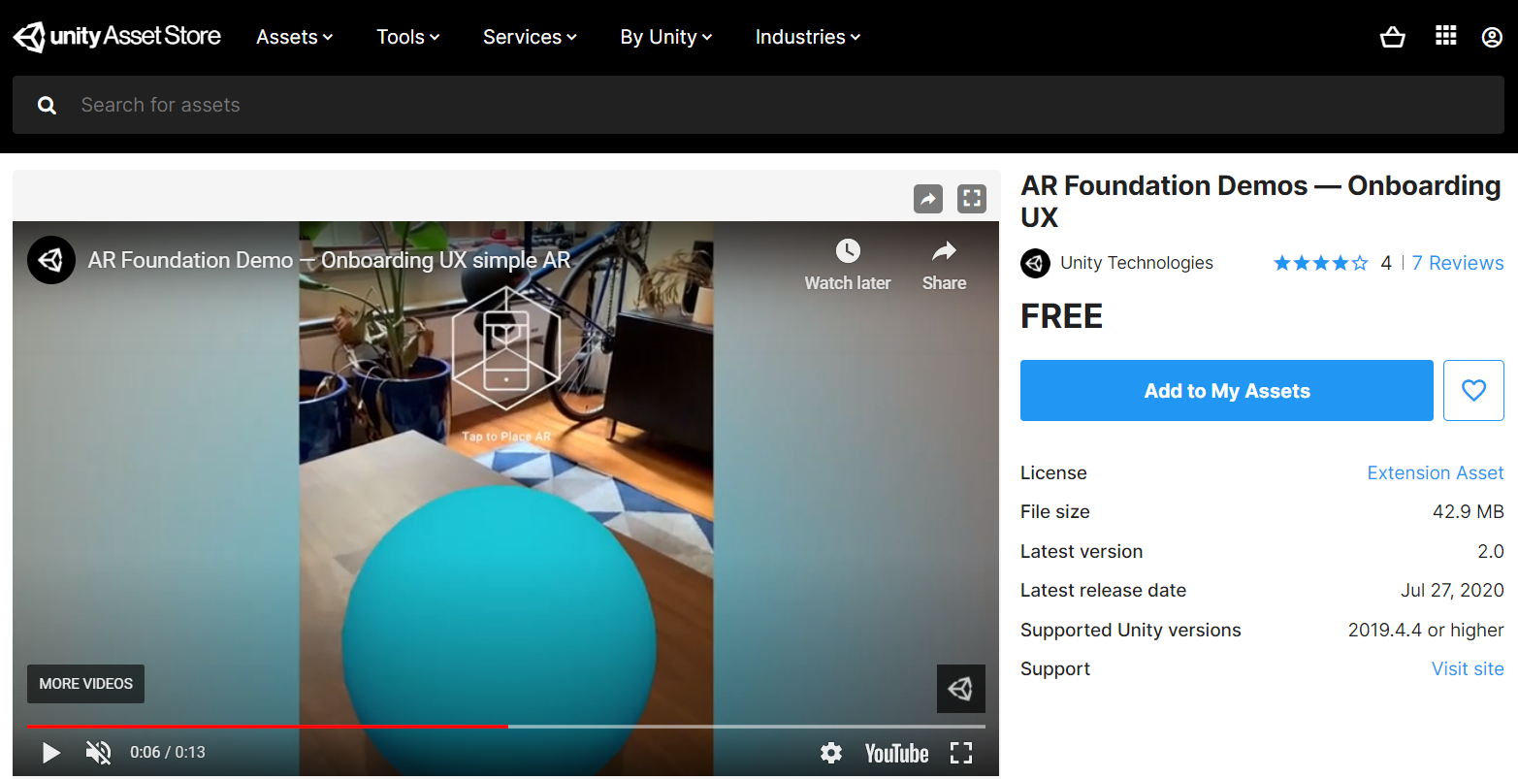
Want to make AR apps? Search template from Assets Store

Slide 16
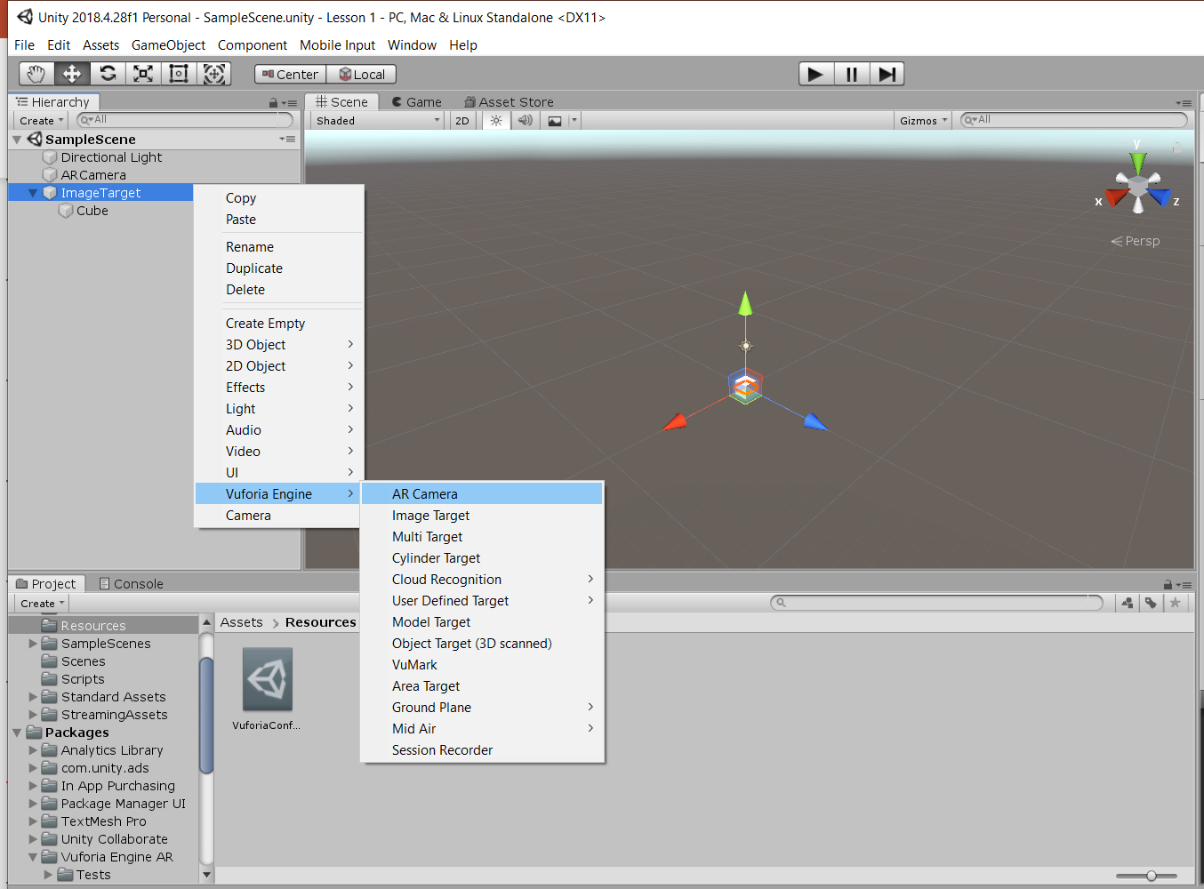
Want to make AR apps? Or used integrated Vuforia AR Engine
Step 1: Delete existing Camera
Step 2: Add AR Camera
Step 3: Add Image Target

Slide 17
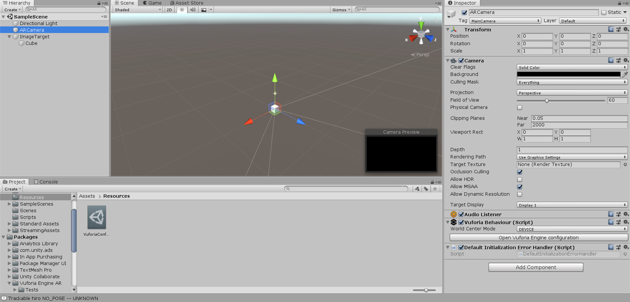
Want to make AR apps? Or used integrated Vuforia AR Engine

Slide 18
Want to make AR apps? Or used integrated Vuforia AR Engine

Slide 19
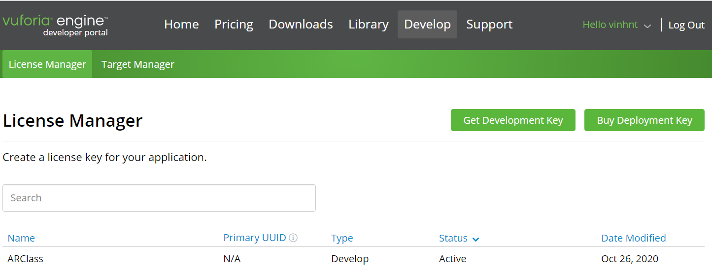
Want to make AR apps? Or used integrated Vuforia AR Engine

Slide 20
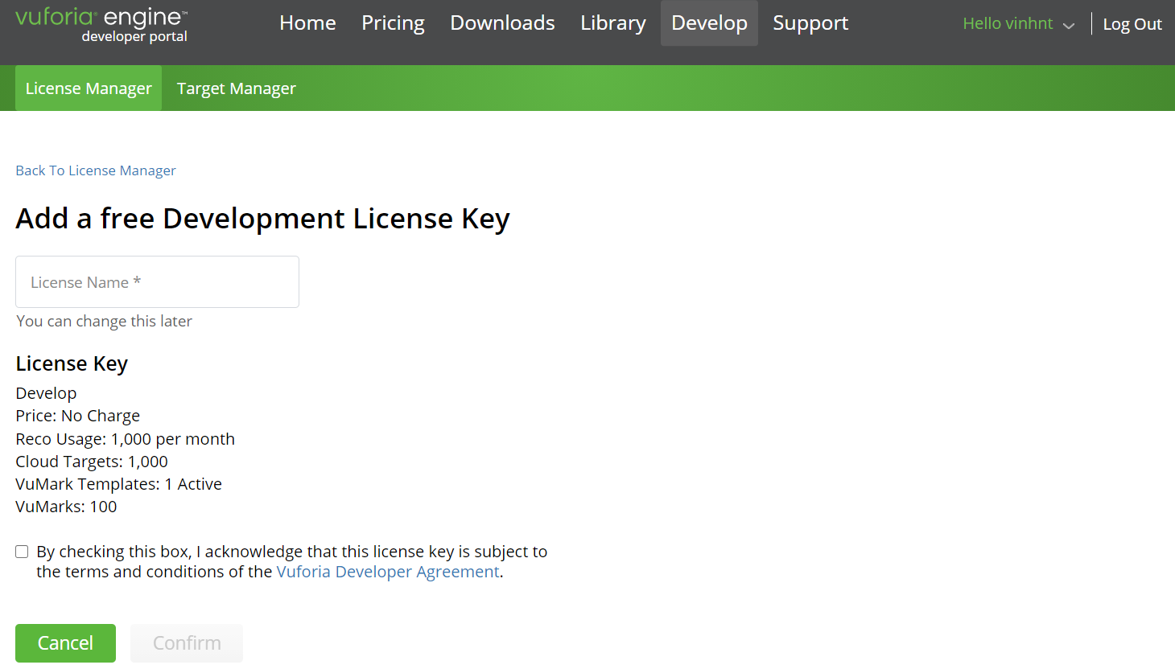
Want to make AR apps? Or used integrated Vuforia AR Engine
Your project license name

Slide 21
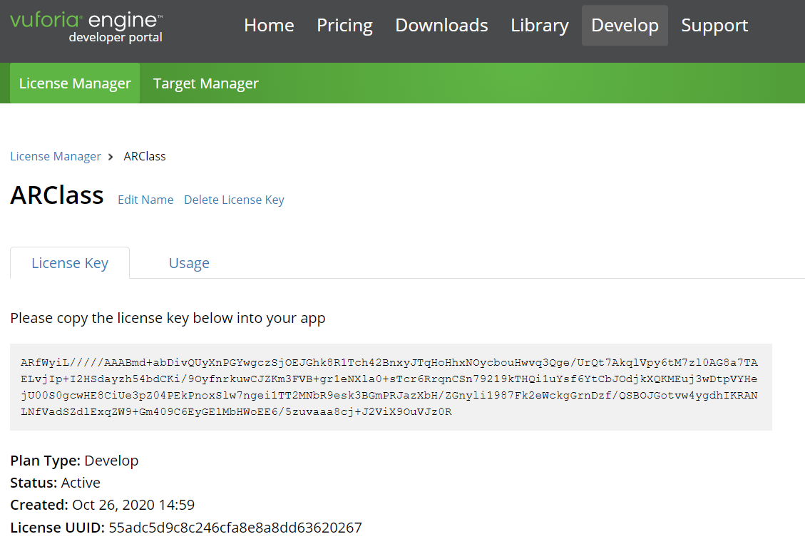
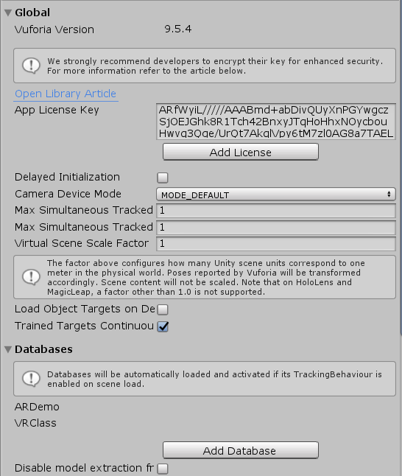
Want to make AR apps? Or used integrated Vuforia AR Engine
Copy your license

Slide 22
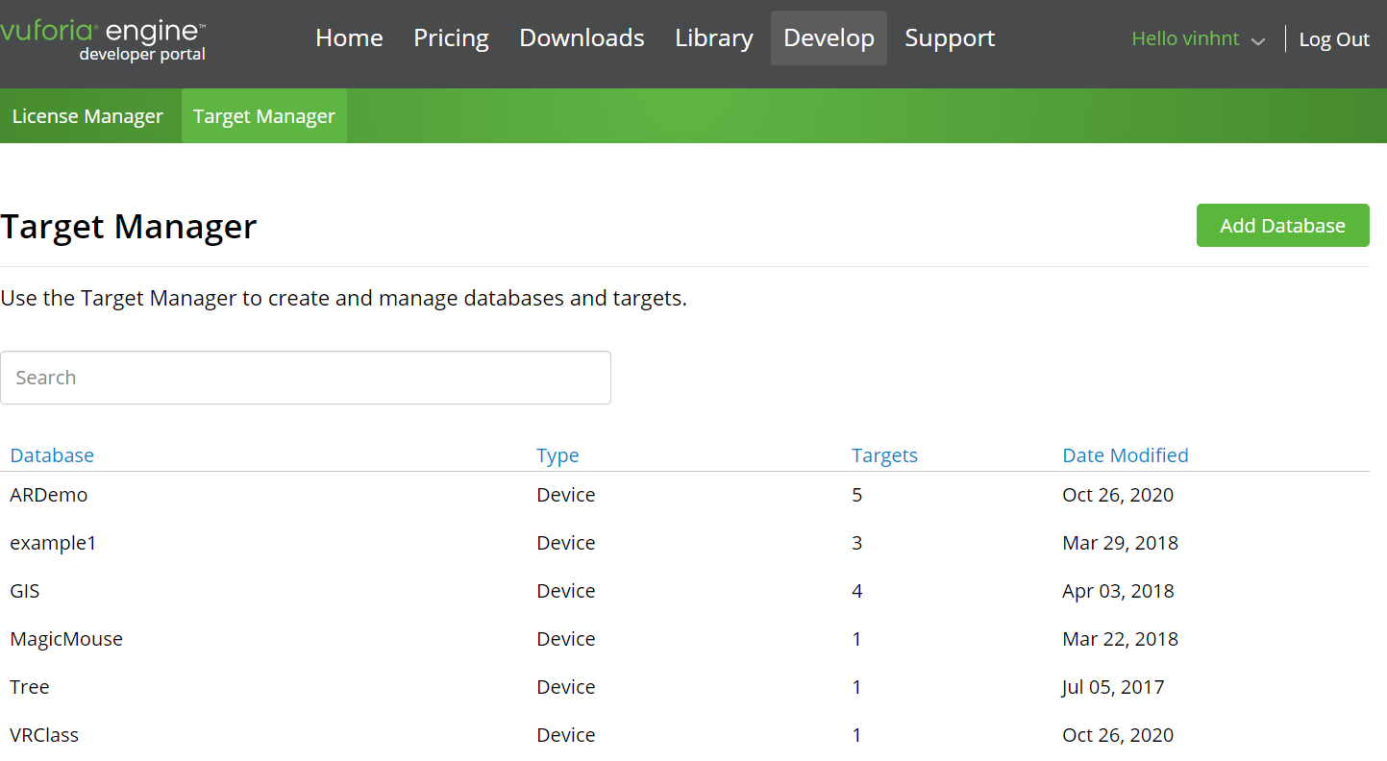
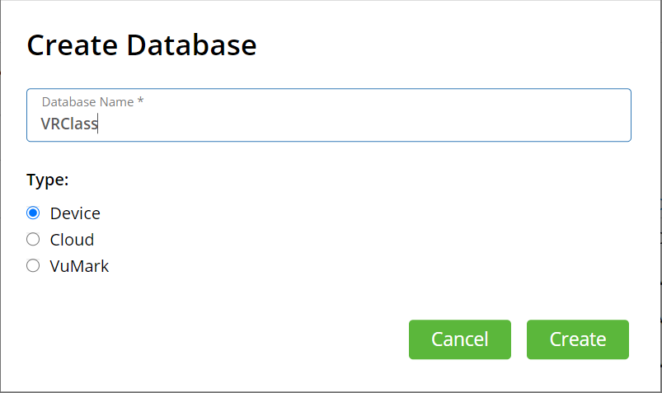
Want to make AR apps? Or used integrated Vuforia AR Engine

Slide 23
Want to make AR apps? Or used integrated Vuforia AR Engine

Slide 24
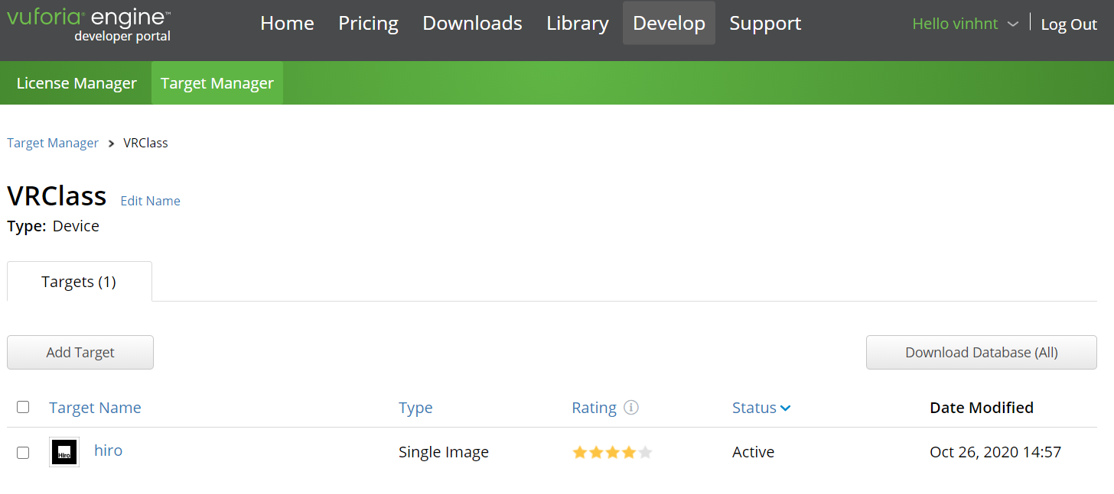
Want to make AR apps? Or used integrated Vuforia AR Engine

Slide 25
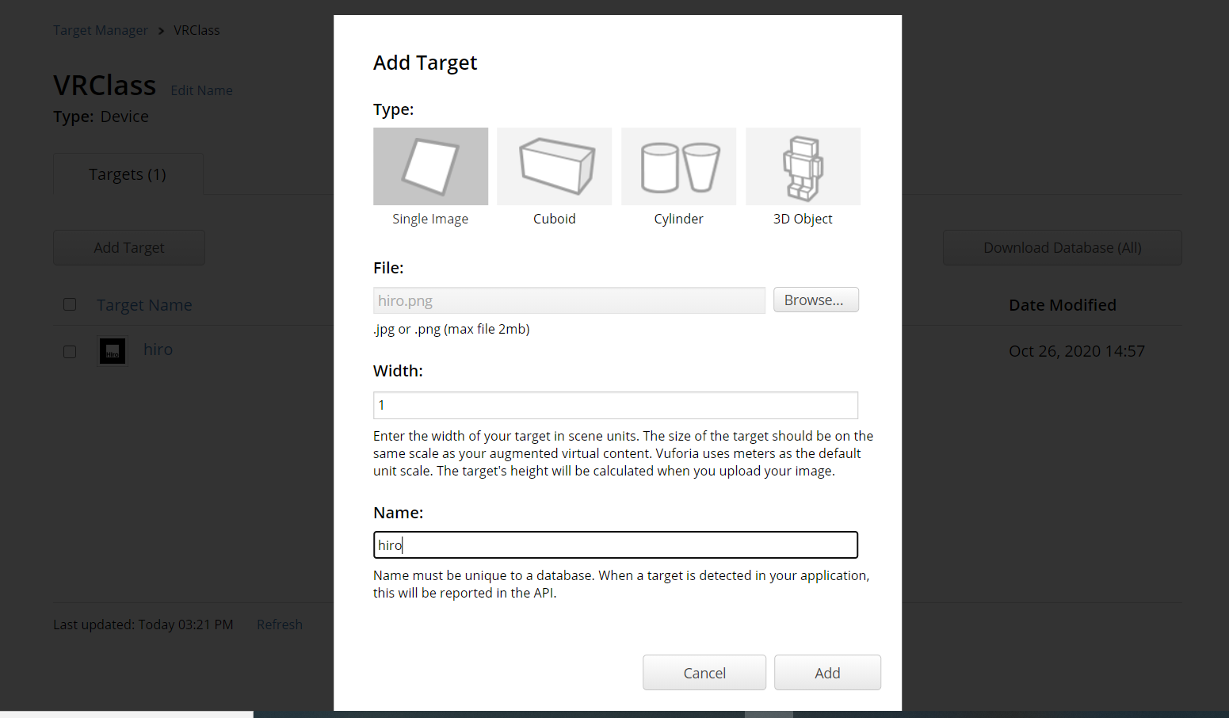
Want to make AR apps? Or used integrated Vuforia AR Engine

Slide 26
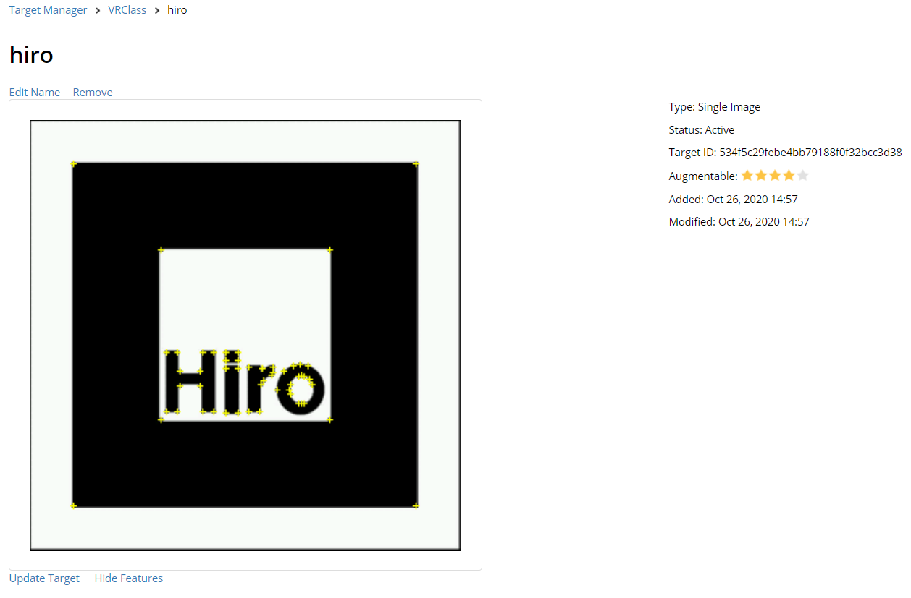
Want to make AR apps? Or used integrated Vuforia AR Engine

Slide 27
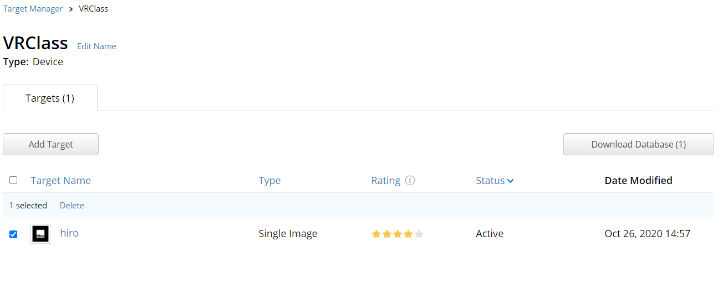
Want to make AR apps? Or used integrated Vuforia AR Engine

Slide 28
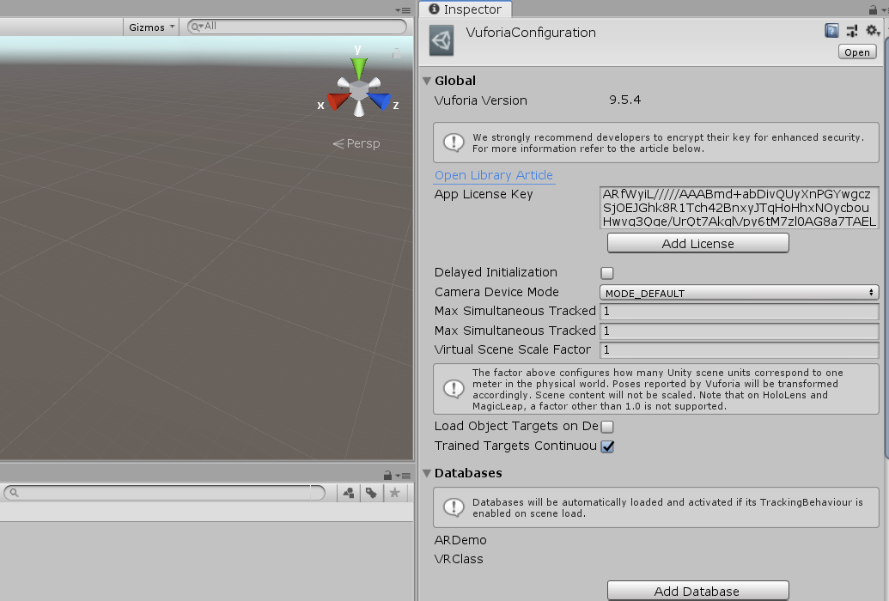
Want to make AR apps? Or used integrated Vuforia AR Engine

Slide 29
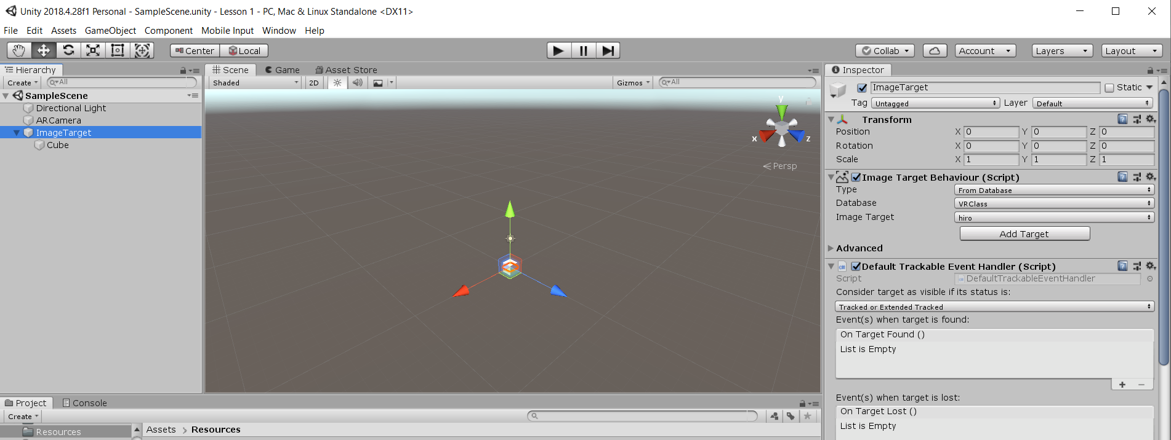
Want to make AR apps? Or used integrated Vuforia AR Engine

Slide 30
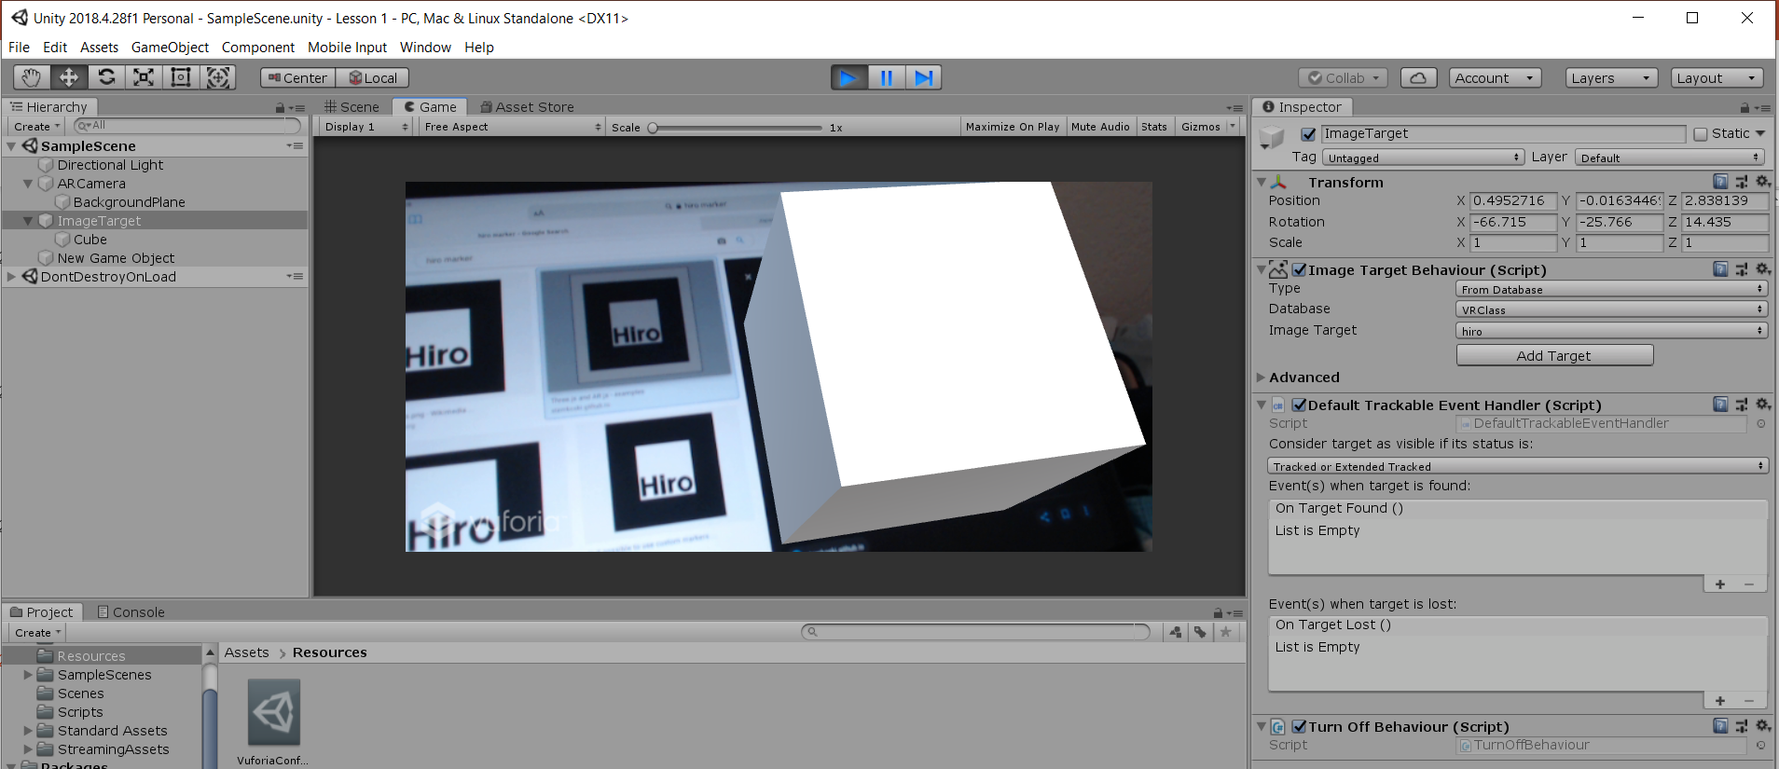
Want to make AR apps? Or used integrated Vuforia AR Engine

Slide 31
Questions?

