Slide 1
Three.js

Slide 2
Outlines
Creating a scene
Working with basic components that make up a scene
Working with light sources
Working with geometries
Loading meshes and animations
Particles, Particle System, and Interactions

Slide 3
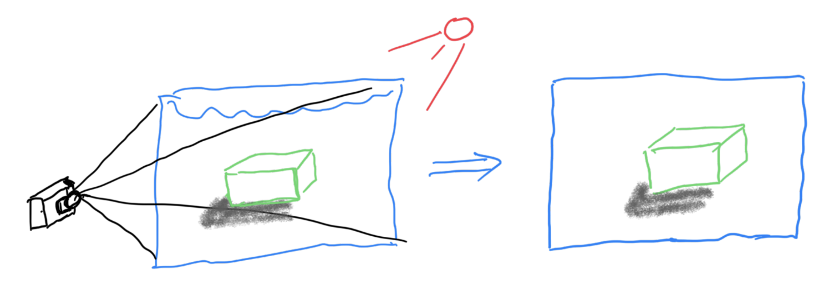
Basic components
spot light
ambient light
Canvas
scene
y
Renderer
x
(0, 0, 0)
object
Z
camera
Back-end processing
Front-end view (html)

Slide 4
Coordinate and Units?
One unit is one meter (by convention)
Objects are placed at the origin (by default)
y
View size at the origin?
($2 ×\tan\left(22.5\right)×16∼17.85)$
45
(0, 0, 0)
x
(-16, 0, 0)
z

Slide 5
Read the docs: threejs.org
http://three.js.org

Slide 6
Download the three.js library
http://three.js.org
Here

Slide 7
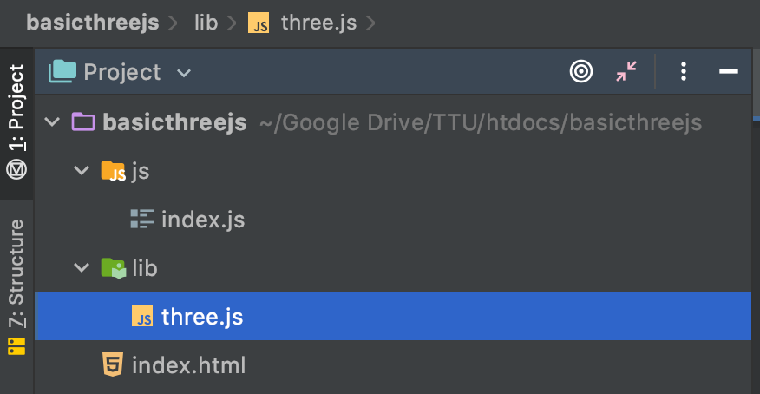
The main project structure
3. Copy
2. New project
1. Extracted three.js
4. Create

Slide 8
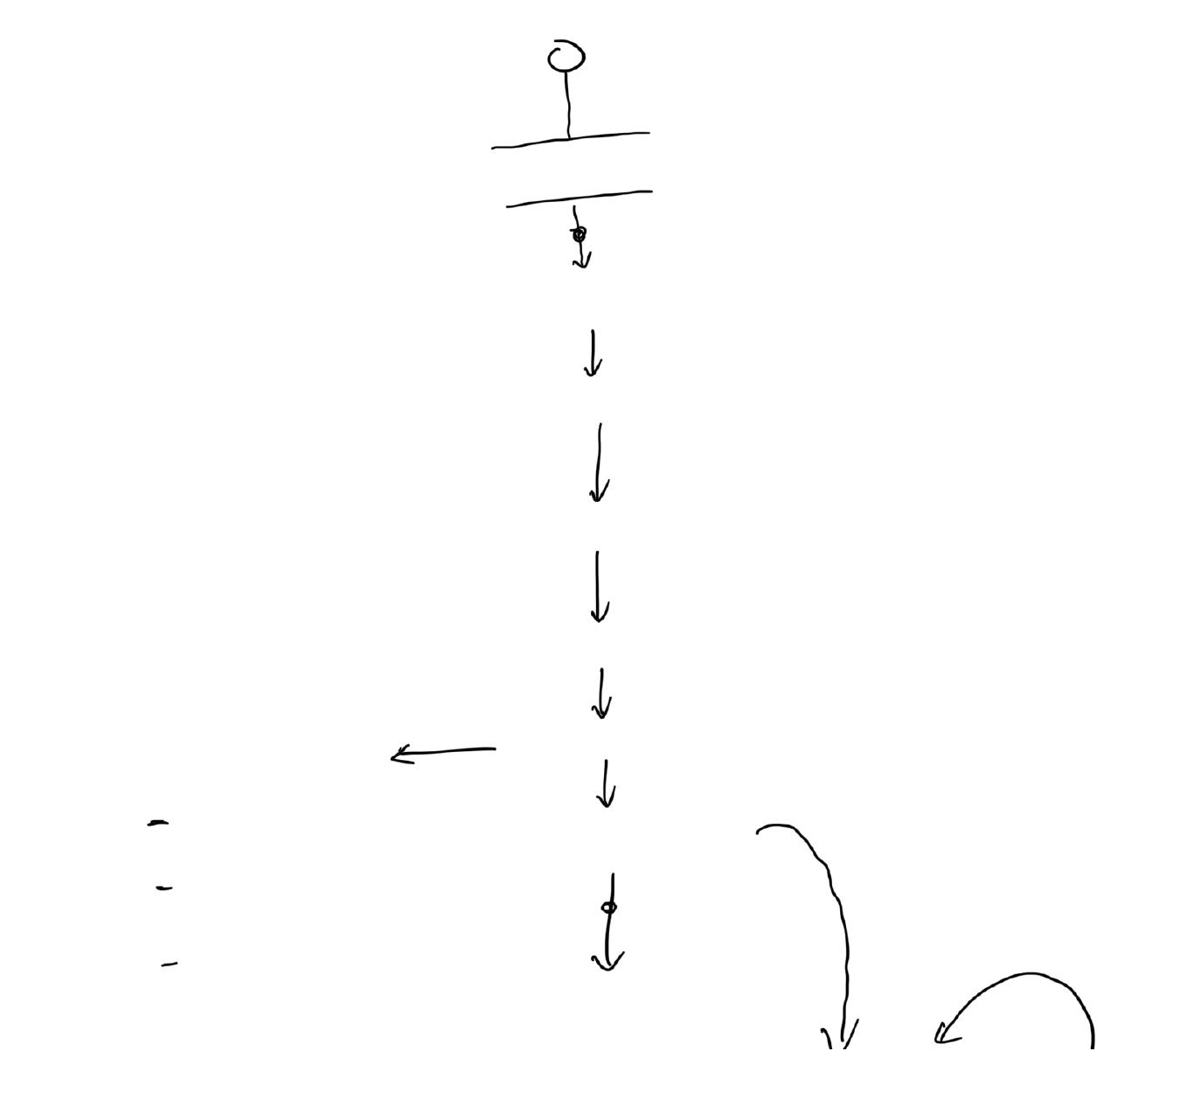
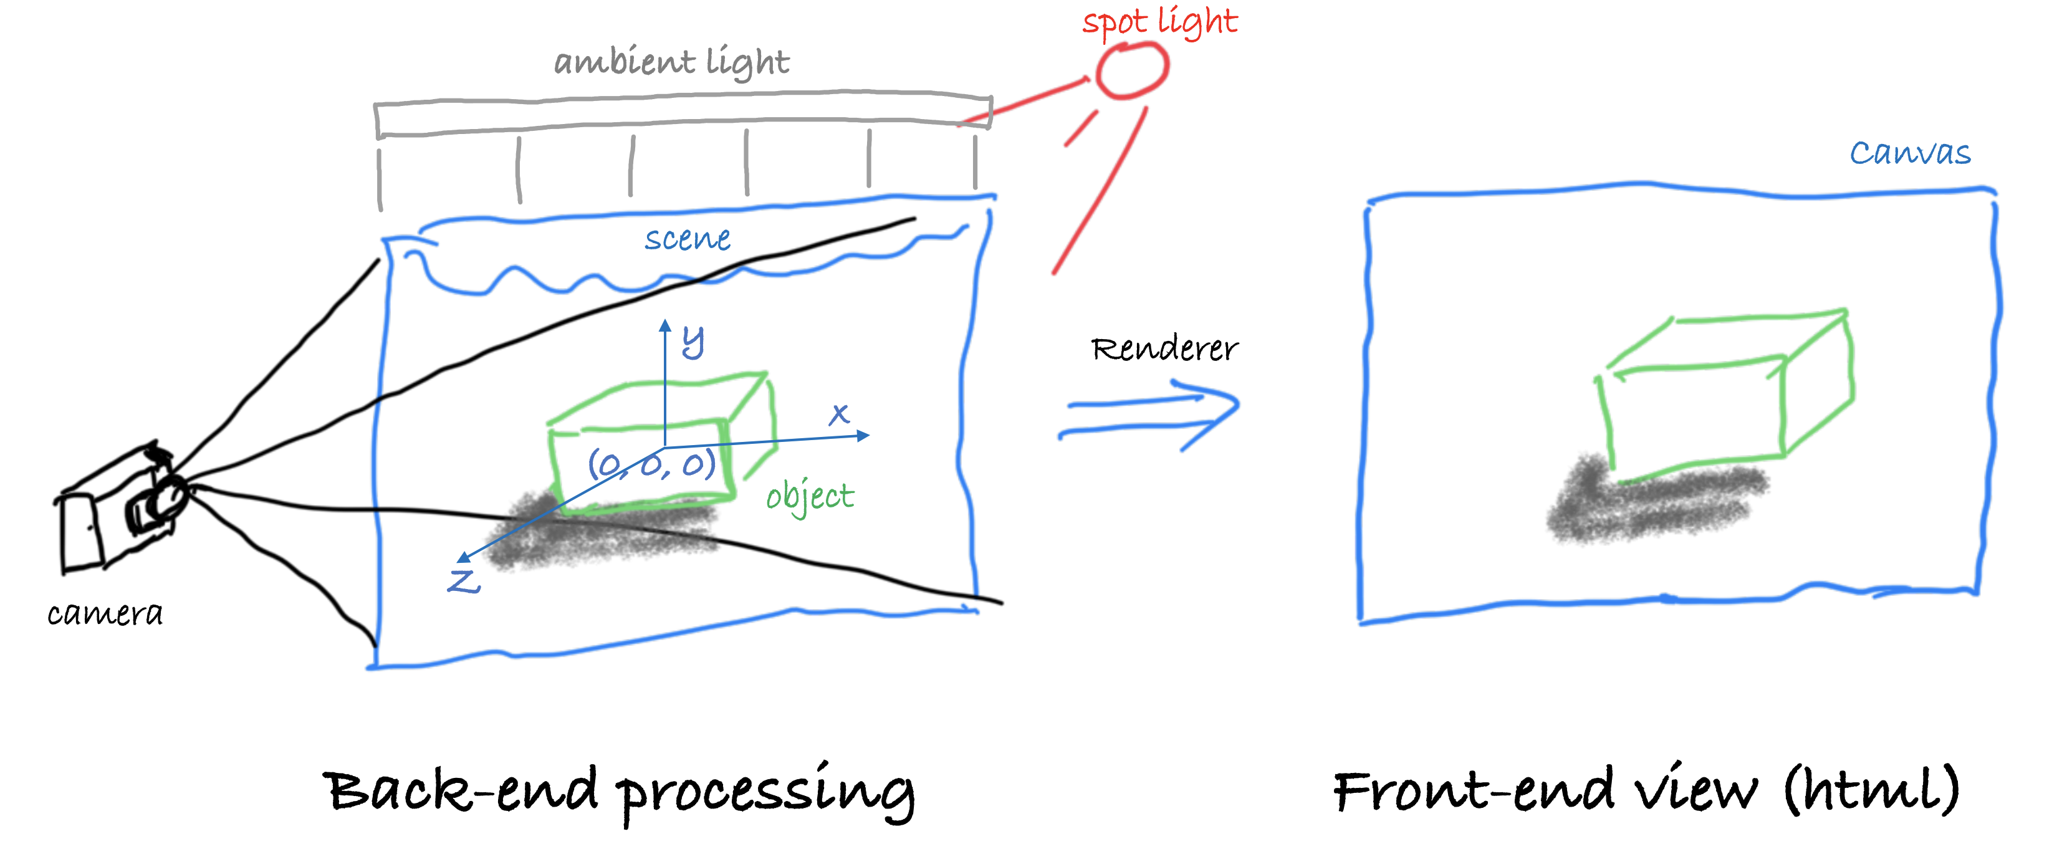
Code structure (boilerplate)
variablxes
init()
scene
renderer
camera
fillObjectsToScene
fillObjectsToScene()
cube
render
plane
requestAnimationFrame
lights
window.onload = init
render()

Slide 9
The global variables

Slide 10
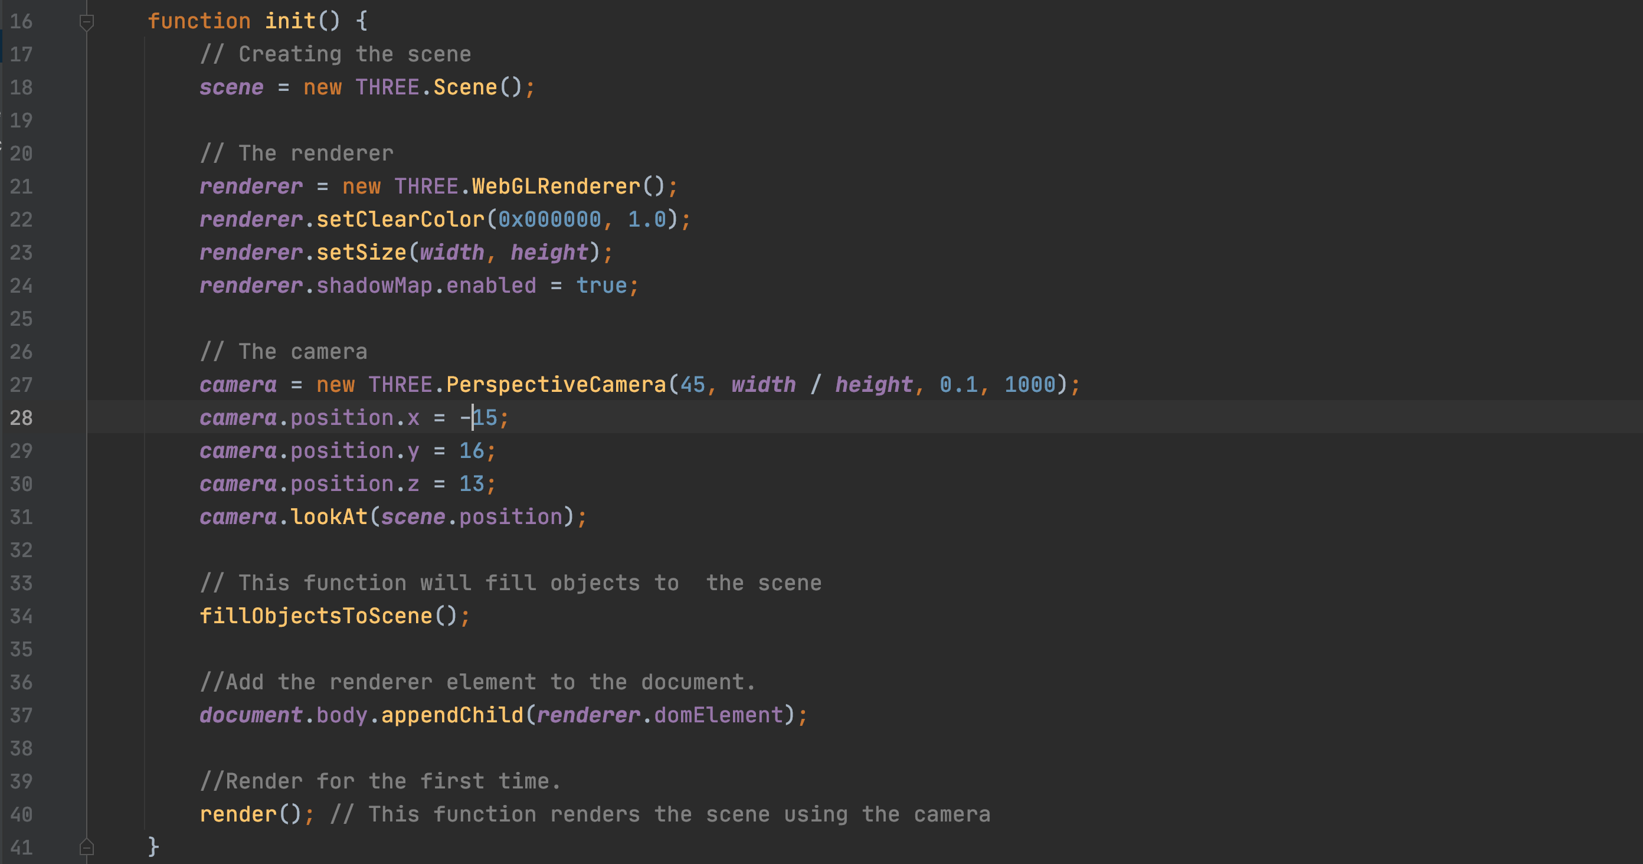
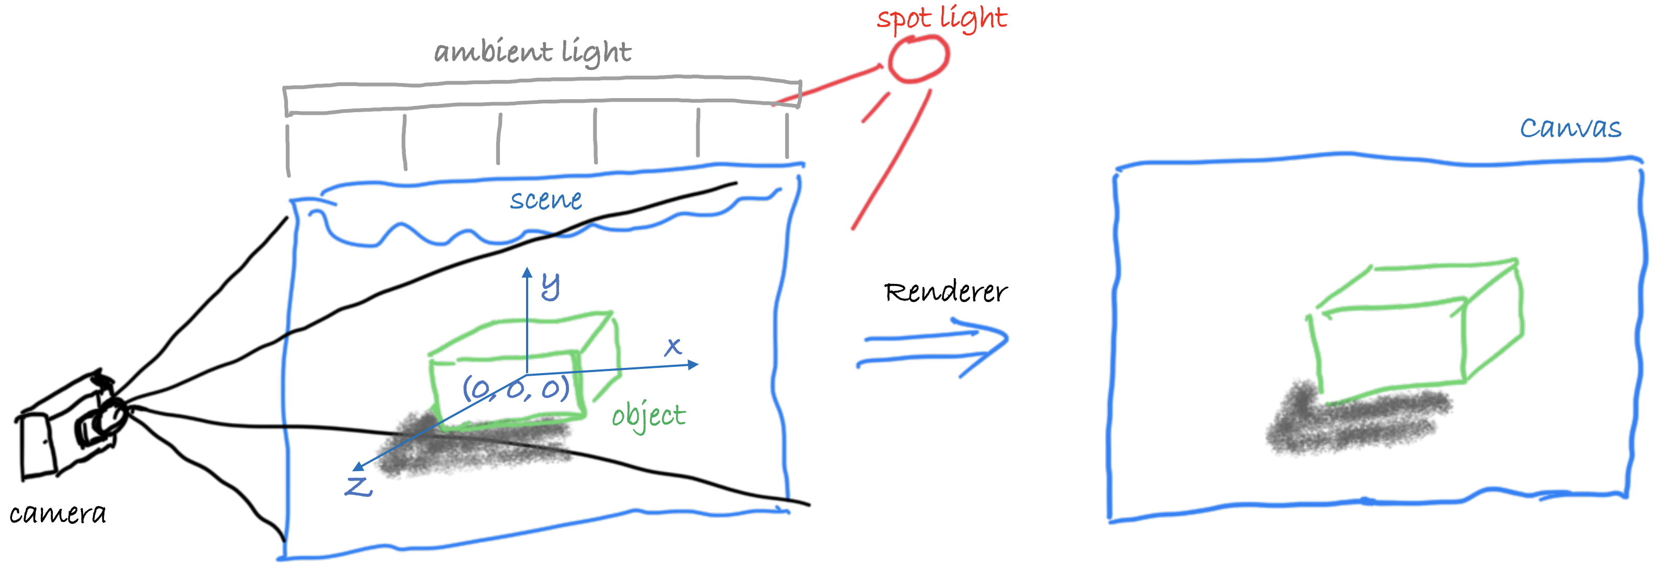
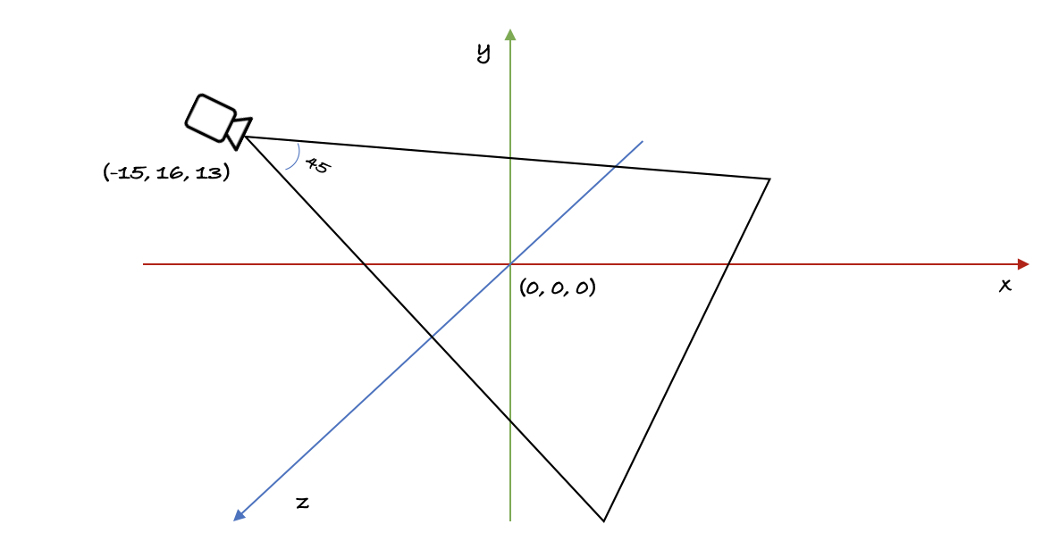
The init() method – boilerplate

Slide 11
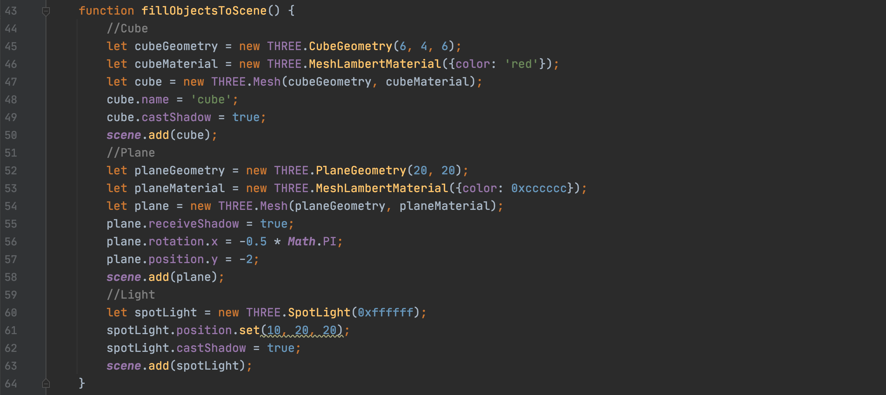
A cube and a plane (working with geometries)
y
y
x
z
z

Slide 12
Render loop (boilerplate)
Start with init()

Slide 13
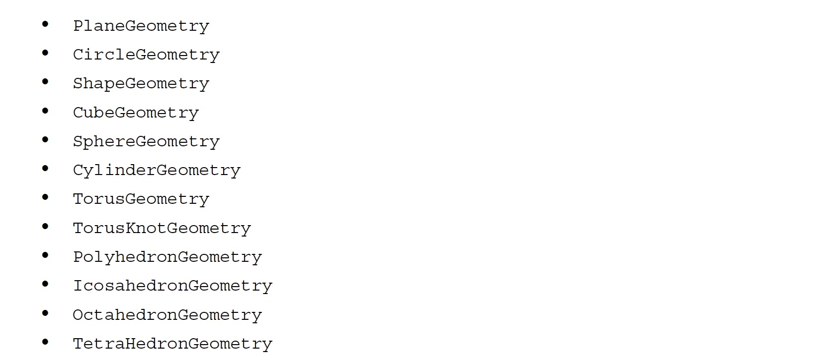
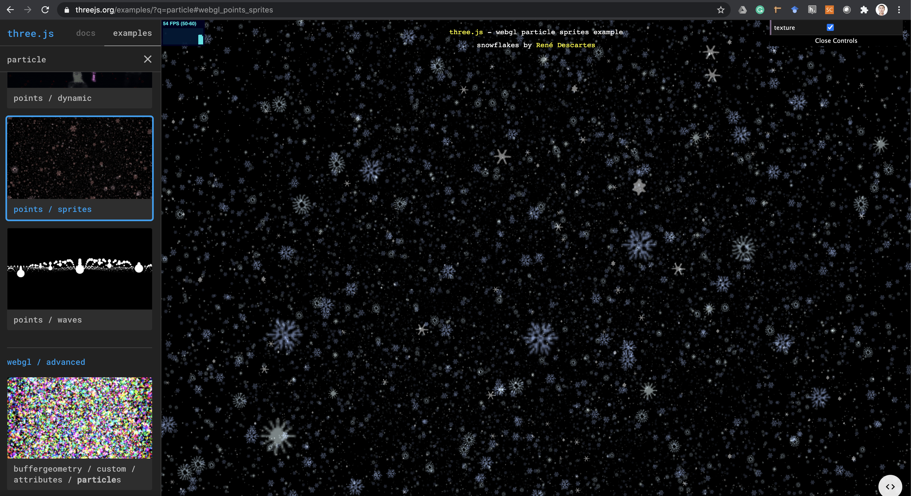
Some other geometries
You can also create your own geometries with vertices and faces
You can also create particle systems with points (point cloud)

Slide 14
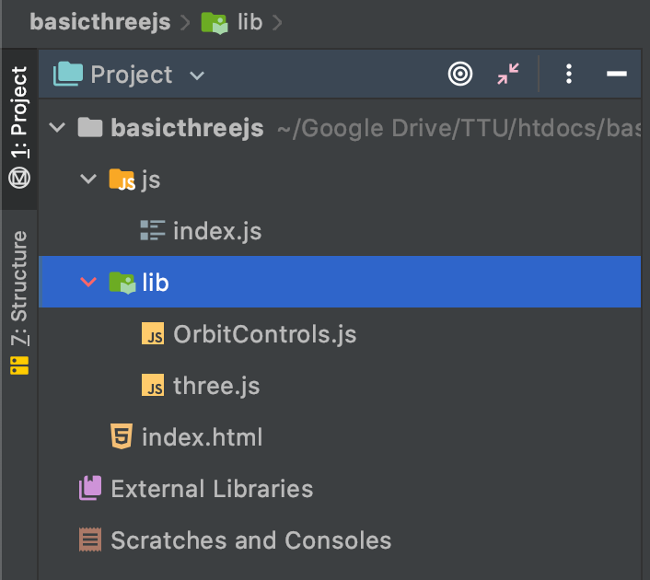
Adding orbit control
1. Extracted three.js
2. The project
3. Copy

Slide 15
Update the code to enable orbit controls
1. Header section
2. Global variable section
3. init function section
4. render function section

Slide 16
Loading models

Slide 17
Loading models
There are external modeling programs
3D Studio Max, Maya, Blender
There are several formats
OBJ, Collada, FBX
The Graphics Layer Transport Format (glTF) is getting popular for the web
List of loaders examples:
https://threejs.org/examples/?q=loader
Access three.js Github repo for some free models
https://github.com/mrdoob/three.js/tree/master/examples/models/gltf

Slide 18
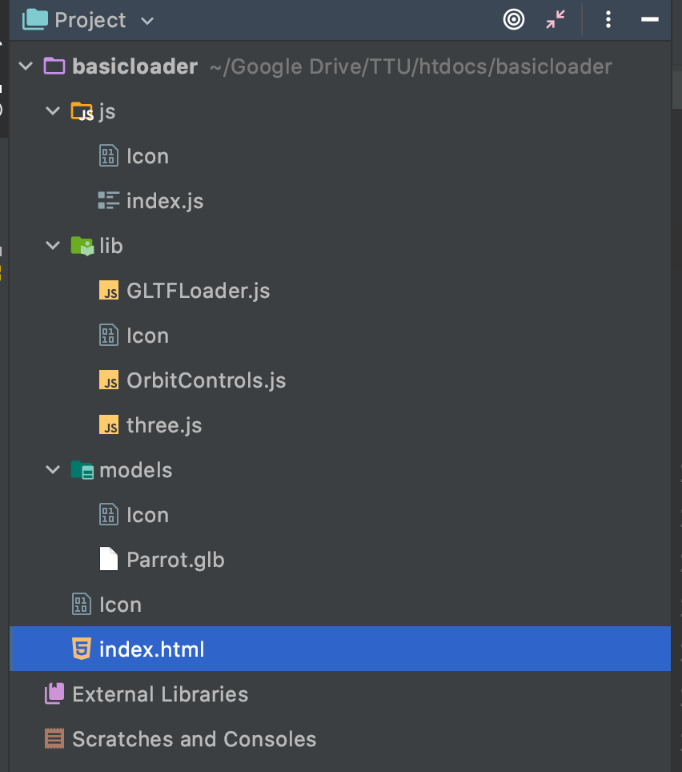
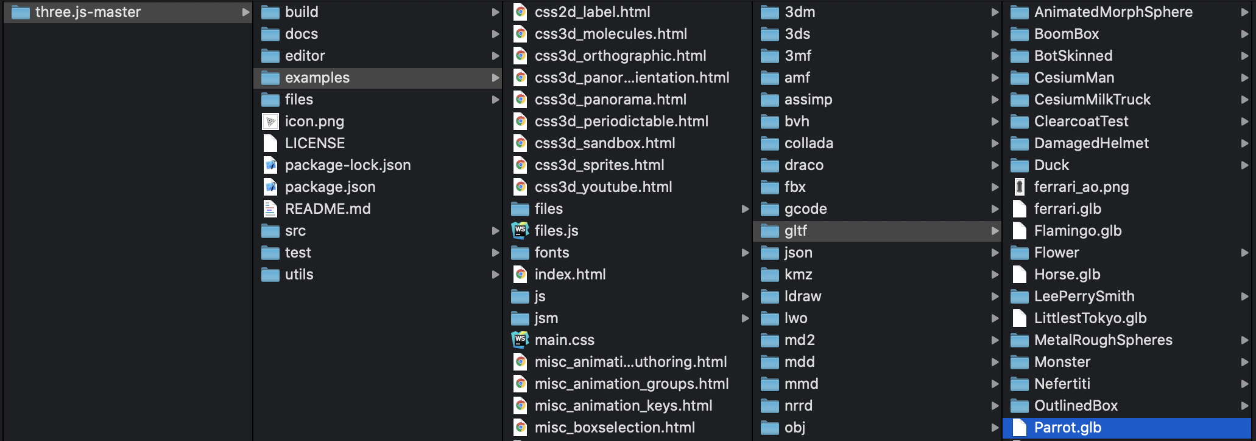
Use the same project structure
1. Extracted three.js
2. The project
3. Copy
4. Copy

Slide 19
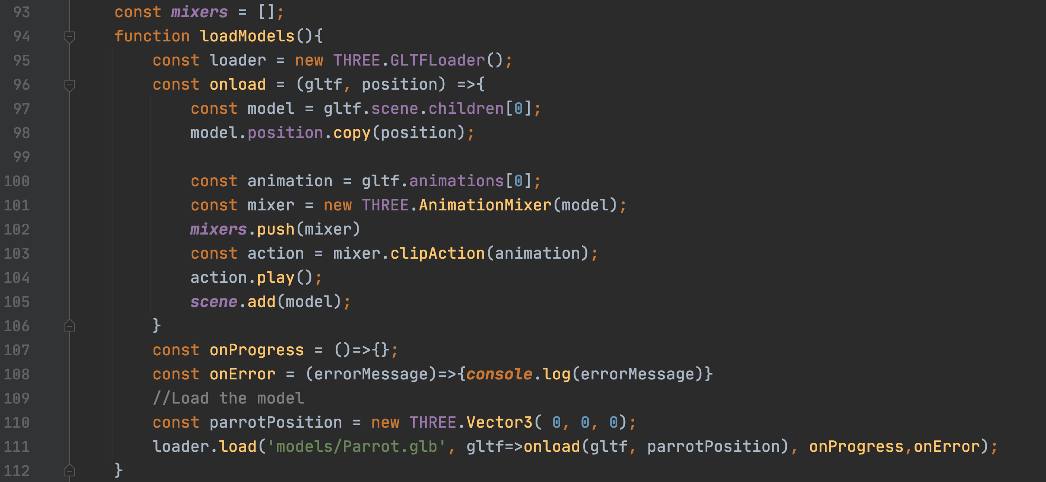
The loadModels function

Slide 20
Update the codes
1. Header section
2. Global variable section
3. init function section
4. render function section

Slide 21
Particle systems and interactions

Slide 22
Codes extracted from this project
Example:
Github: https://github.com/iDataVisualizationLab/Soil
Github page: https://idatavisualizationlab.github.io/Soil/soil3d.html

Slide 23
Creating the point cloud geometry (1/2)
1. Geometry with positions and colors (js/3d/pointcloud.js)

Slide 24
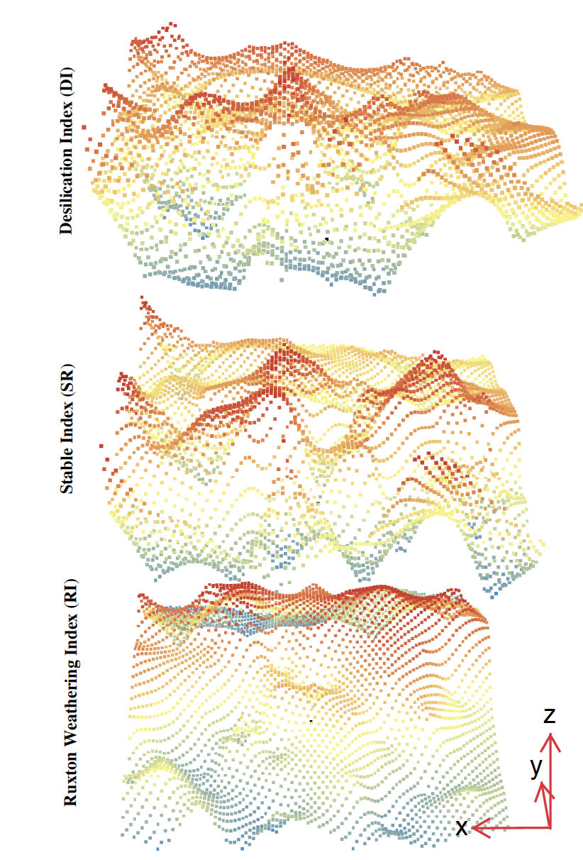
Creating the point cloud geometry (2/2)
2. Creating the geometry for points (js/3d/pointcloud.js)
https://diglib.eg.org/bitstream/handle/10.2312/envirvis20201094/017-024.pdf?sequence=1&isAllowed=y

Slide 25
Creating the point cloud
3. Creating the points (js/3d/pointcloud.js)

Slide 26
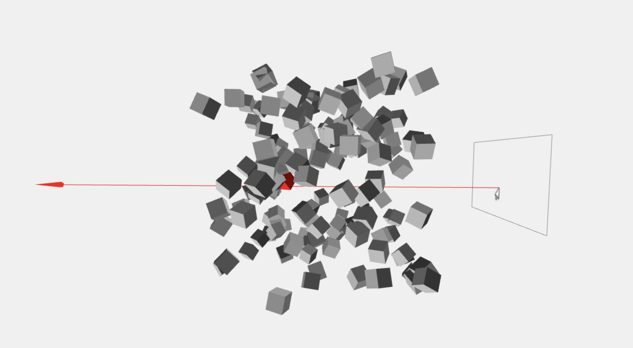
Interactions: Dragging and Raycaster
1. Copy DragControls from threejs library and import it (main3d.html)
2. Handle events for drag controls (js/3d/main3d.js)
3. Commonly used properties/methods
Note: You can also use Raycaster to implement your own interactions:
https://threejs.org/docs/#api/en/core/Raycaster

Slide 27
Good tutorials
This shows a good review of the basic concepts:
https://davidlyons.dev/threejs-intro/#slide-0
This shows a good tutorial of the loader
https://discoverthreejs.com/book/first-steps/load-models/

Slide 28
References
Three.js documentation: https://threejs.org/docs/
Three.js examples: https://threejs.org/examples/
SoilScanner: 3D Visualization for Soil Profiling using Portable X-ray Fluorescence https://github.com/iDataVisualizationLab/Soil
Loading external model: https://discoverthreejs.com/book/first-steps/load-models

