Slide 1
Machine Learning with JavaScript

Slide 2
Resources

Slide 3
Why ML with JS?
Server cost
Lowered inference latency
Audio, Video, Images
Data privacy
Instant WebGL acceleration
Supports for GPU acceleration
Instant access
Zero install
Portability
Works on multiple platforms
Can switch to server mode with Node.js

Slide 4
Components of a ML System
Visualization
Custom codes with d3.js
plotly.js (similar to pyplot in Python) and others (cola.js, c3.js)
Computation
Custom codes for ML algorithms (See reference 1)
TensorFlow.js (similar to keras in Python) (See reference 2)
Some other packages (tsne.js, scagnostics.js)
Notes:
cola.js, c3.js

Slide 5
Plotly.js
https://plot.ly/javascript/
Visualization library built on top of d3.js
Pros:
Quick to visualize data with rich features and interactions
Cons:
Slow in many cases
Not flexible

Slide 6
Web Worker
https://developer.mozilla.org/en-US/docs/Web/API/Web_Workers_API
ML is computation intensive
Web Worker help to
Support parallelism
Non-blocking GUI (and interaction)

Slide 7
t-Distributed Stochastic Neighbor Embedding
Why tsne?
Linear methods for dimensional reduction vs. Non-linear methods dimensional reduction
Inter-cluster and Intra-cluster distances
tsne.js
https://github.com/karpathy/tsnejs
Playground
https://distill.pub/2016/misread-tsne/

Slide 8
t-SNE main ideas
Kullback Leiber Divergence
 | Dog | Cat | Fish | Horse | Mouse
High dimensional space (P) | 0.5 | x | 0.05 | 0.15 | 0.3
Low dimensional space (Q) | 0.6 | x | 0.06 | 0.14 | 0.2
Distances to probabilities

Slide 9
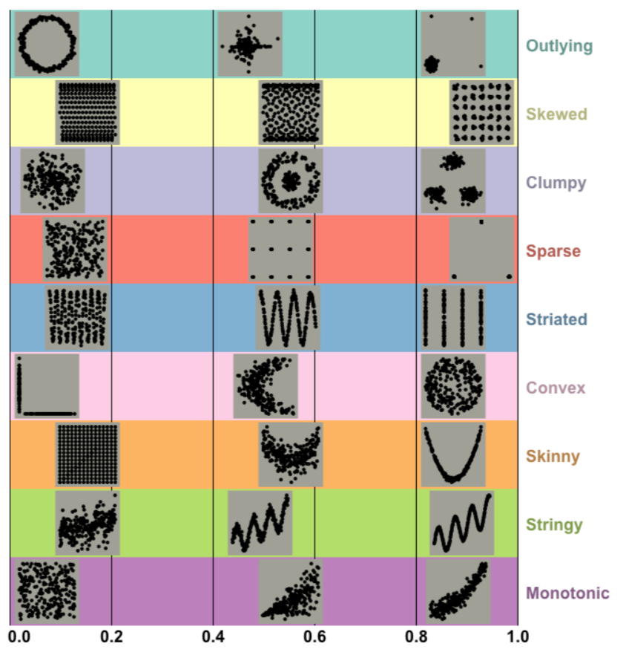
Scagnostics

Slide 10
ScagnosticsJS
Documentation and main ideas
https://idatavisualizationlab.github.io/Scagnostics2018

Slide 11
Natural Language Processing
Natural Language Processing
Sentiment Analysis
Topic Modeling
Resources
spaCy: https://explosion.ai/demos/
IBM: https://natural-language-understanding-demo.ng.bluemix.net/

Slide 12
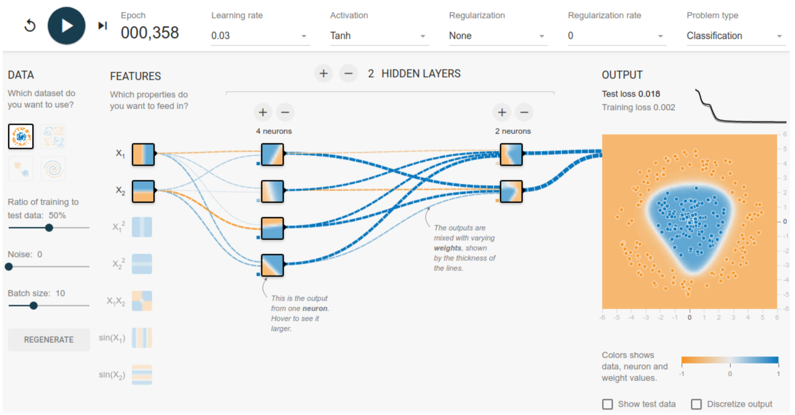
TensorFlow.js
https://playground.tensorflow.org

Slide 13
Example

Slide 14
Installation
Visualization
<script src="https://cdn.plot.ly/plotly-latest.min.js"></script>
Calculation
<script src="https://cdn.jsdelivr.net/npm/@tensorflow/tfjs@0.12.2"> </script>

Slide 15
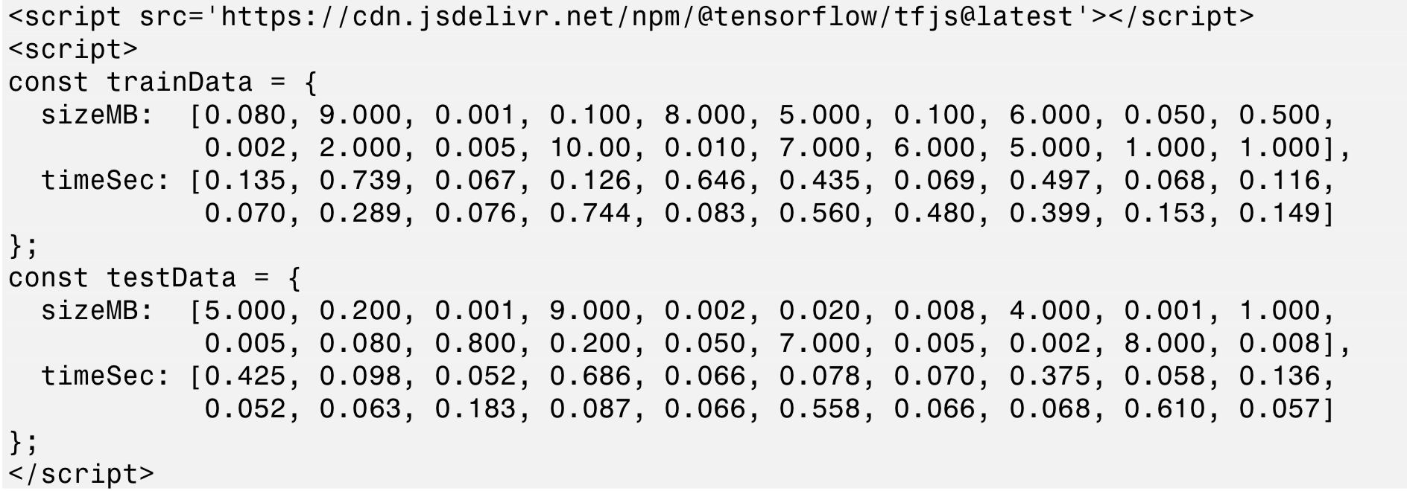
Data
https://codepen.io/tfjs-book/pen/dgQVze

Slide 16
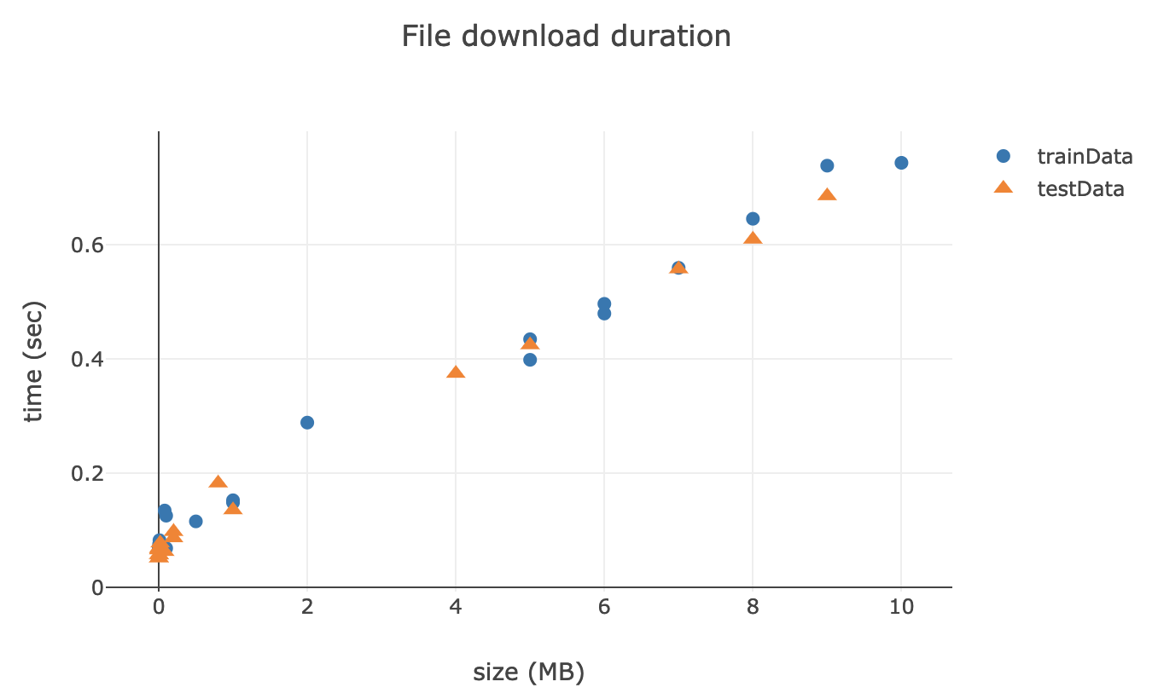
Visualization
https://codepen.io/tfjs-book/pen/dgQVze

Slide 17
Converting data into tensors

Slide 18
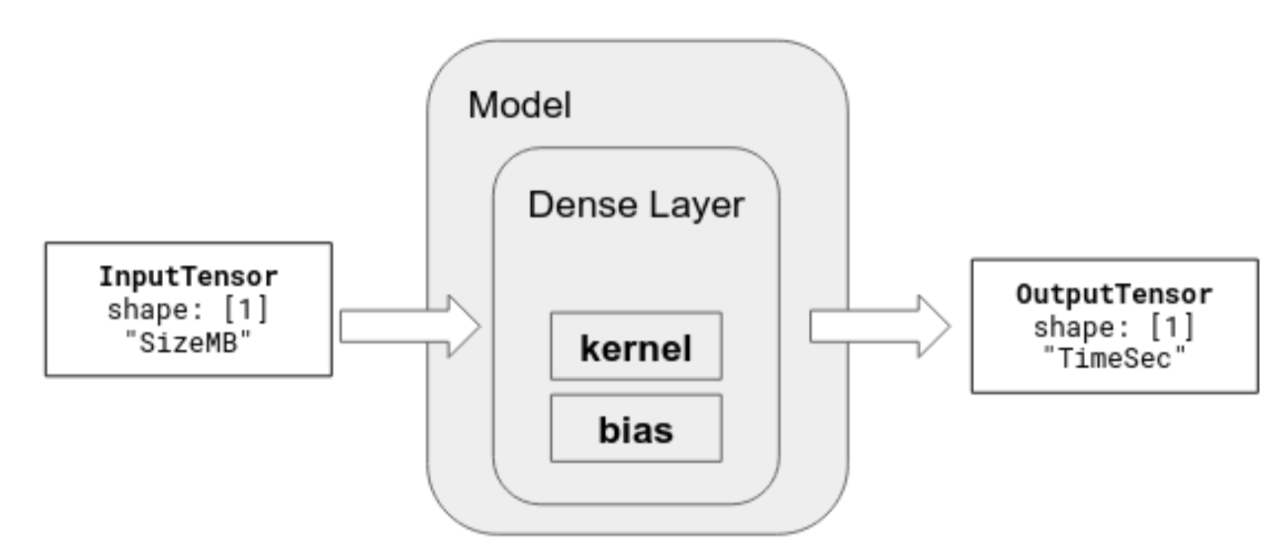
Defining a simple model
Defining the model
Compiling the model
Simple linear model in this case

Slide 19
Fitting the model

Slide 20
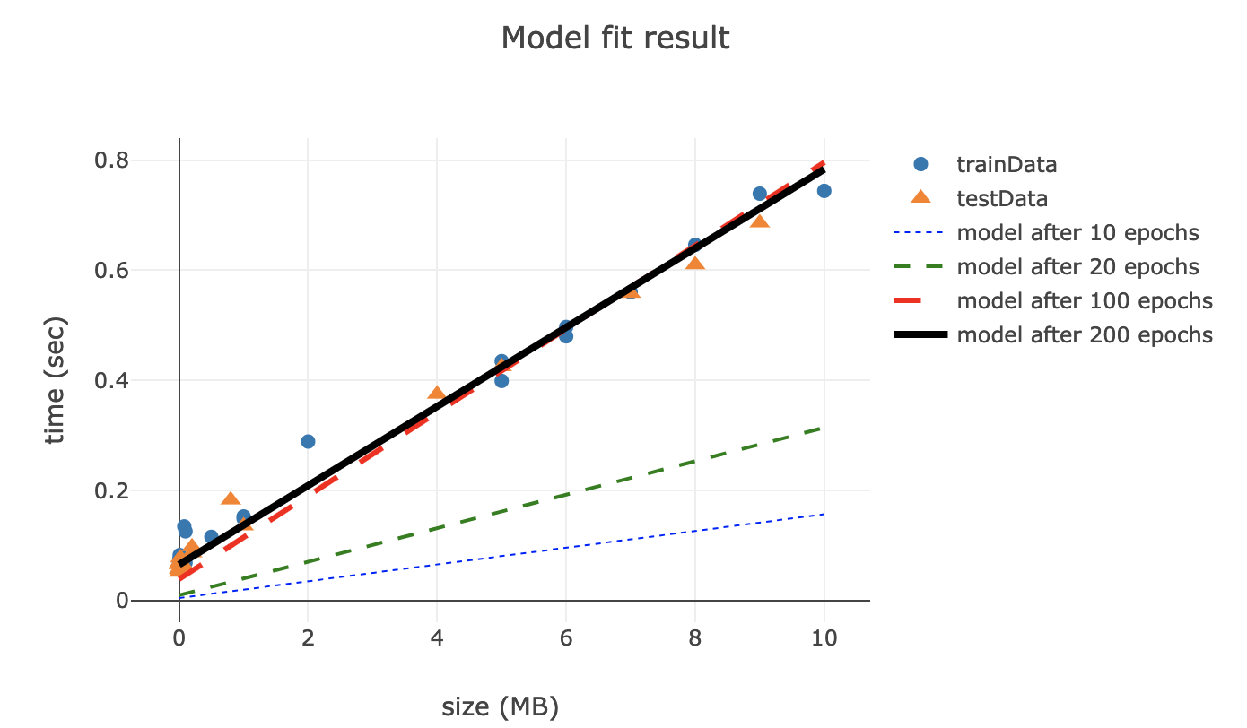
Results for different epochs
https://codepen.io/tfjs-book/pen/VEVMMd

Slide 21
References

